Slide 1
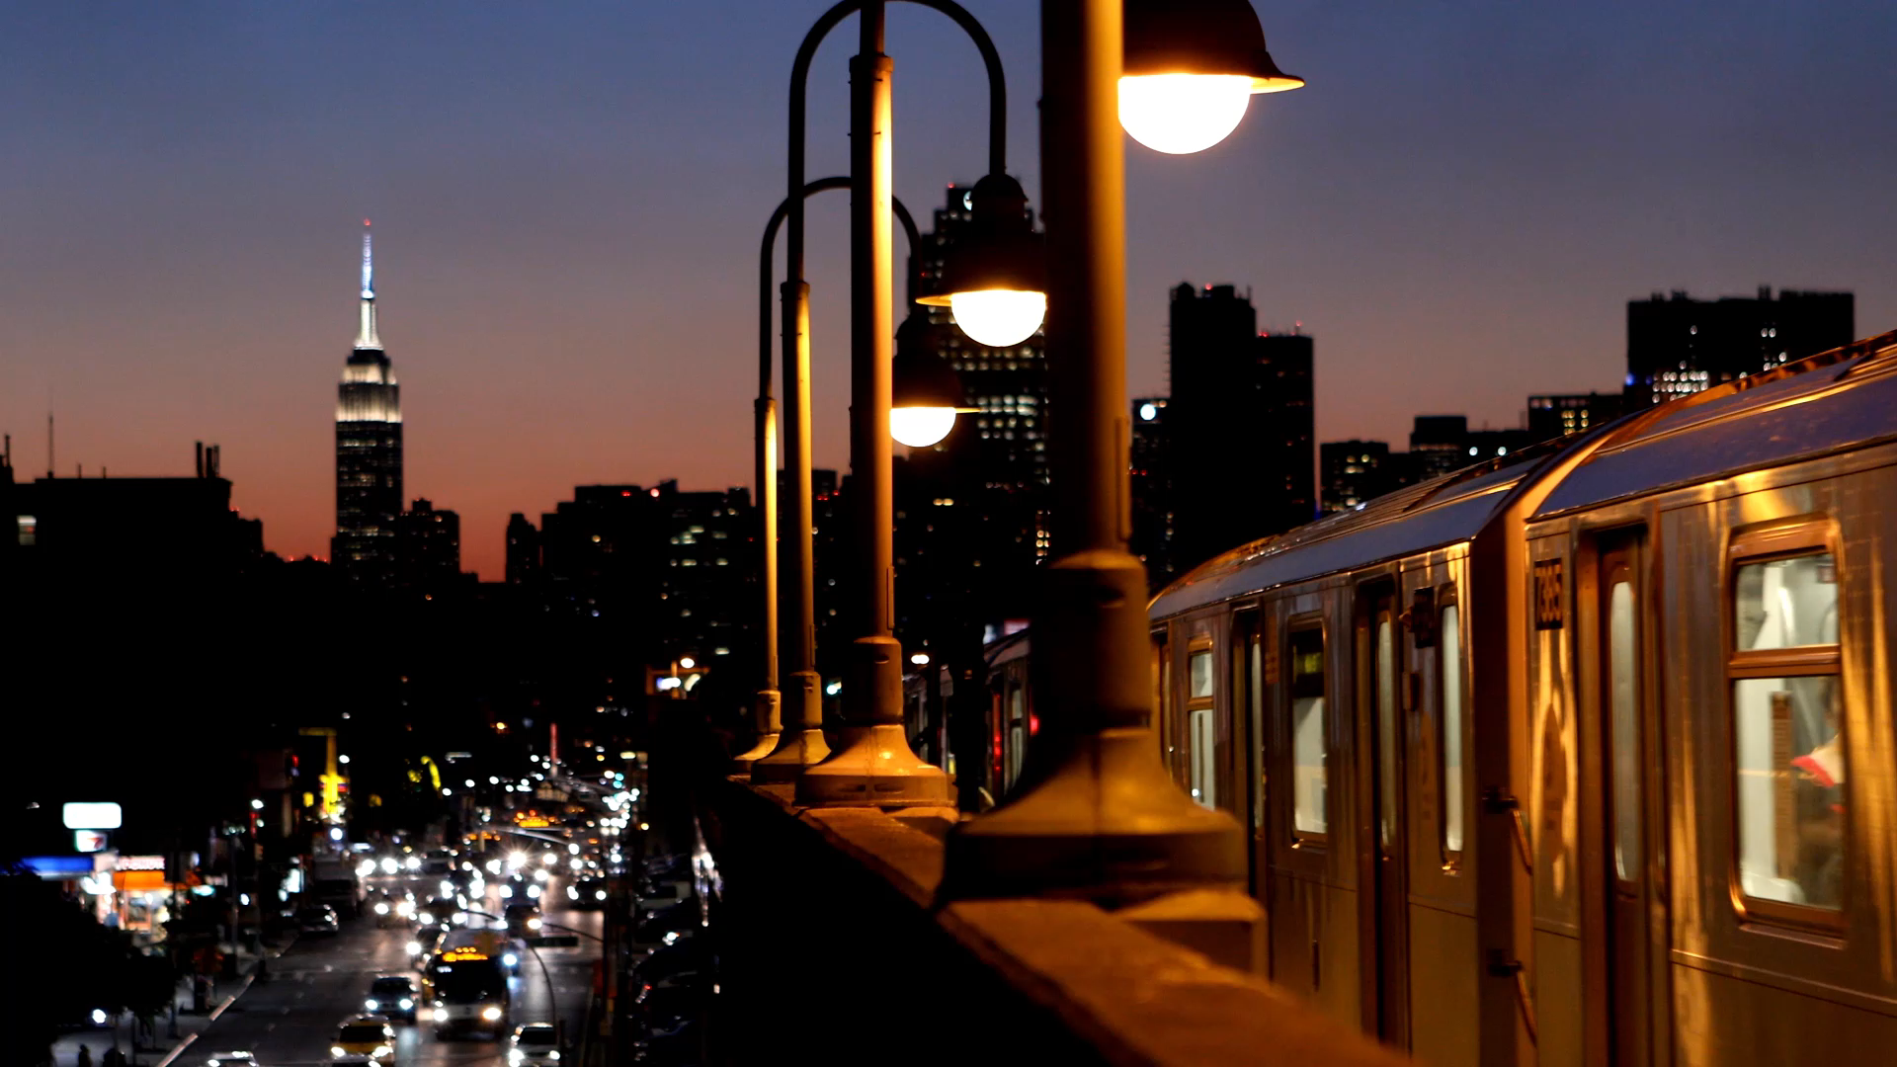
DAA SEMINAR BASED ON M – COLOURING
GROUP MEMBERS :
U19CS001 : PARVA SHAILESHKUMAR PATEL
U19CS025 : JINIL JIGARKUMAR THAKKAR
U19CS026 : SUMEET SANJAY KAMBLE
U19CS030 : YASH MAHESHBHAI PATEL

Slide 2
Problem Statement
You are given a undirected graph.
Now colour each vertices using maximum M colours such that no two adjacent
vertices have same colour .
INPUT
First line of input consist of an integer N denoting number of vertices.
Second line of input consist of an integer M denoting number of colours that can be used to colour.
Third line of input consist of an integer E denoting number of Edges.
The next E lines each contain two space-separated integers u and v ( denoting undirected edge
between vertices u and v ) .
OUTPUT
If Coloring is Possible : then Print “ Solution Does Exist”.
Also , Print the Colour Order in the Order of Vertex i.e C1 C2 C3 …
If Colouring is not possible using M colours : then Print “ Solution Does Not Exist” || return False.

Slide 3
We will solving the given problem using three algorithms:
Namely:
1.) Simple Recurrison
2.) Backtracking
3.) Using BFS (Breadth – First – Search )
To Understand the Working of Algorithm , Let us take an Example :
10
3
15
2
1 3
6
7
8
4
9
5
8
6
5 7
6 10
7 9
8 10
9 10

Slide 4
Approach 1 : Simple Recurrision
Assumptions :
Here , only 3 colours since M = 3 .
White color as colourless / un-coloured = 0
Red colour = 1
Blue colour = 2
Orange colour = 3
A colour Array with nos. of elements = nos. of vertices = N (here = 10)
Say C[10] , and Initializing all elements with 0 ( i.e colourless )
C = { 0 , 0 , 0 , 0 , 0 , 0 , 0 , 0 , 0 , 0 };
Graph[n][n] is a binary matrix , in which if Graph[i][j] = 1 it denotes edge between
I and J and 0 means no edge .

Slide 5
Pseudocode
Algorithm 1 (Naïve Recursive)
We have an adjacency matrix named “graph” of size n x n.
We also have an array named “color” of size n of size n initialized to 0.
We have a function printSolution to print the array “color”

Slide 6
Pseudocode
graphColoring(int graph[V][V], int m, int i, int color[V] )
if i = V then
if isSafe(graph,color) = true
printSolution(color)
return true
return false
for j= 1 to m
set color[i] = j
if graphColoring(graph, m, i+1, color) = true
return true
set color[i] = 0
return true
return false

Slide 7
Pseudocode
isSafe(int graph[V][V], int color[])
for i = 0 to V-1
for j = i +1 to V-1
if graph[i][j] = true and color[j] = color[i]
return false
return true
Driver Function
1 call graphColoring(graph, m, 0, color)
2 if it returns false then print(“Solution does not exit”)

Slide 8
1
= 1
Approach 1 : Simple Recurrision
Algorithm :
We will iterate (i) from vertex 1 to N ( i.e. 10)
And recursively colour next vertices with
C [ i ] + 1
Until we reach till I = N (last vertex)
And then check if the graph is
Safe or Not ,
If the graph is not safe
We will exit current recurrision
And go back to previous recurrision
And set C [ i ] + 1
This is the Given Graph acc. to Input
= 2
= 3
2
4
5
3
6
7
8
9
10

Slide 9
Depth of recursion
C = { 0 , 0 , 0 , 0 , 0 , 0 , 0 , 0 , 0 , 0 }
1
= 1
= 2
Intially :
All Vertices Colourless = 0
(for representation white)
= 0
Depth of recursion = 0
Now ,
we will start iterating
Through vertices using ‘i’ as
An iterator and
We will colour all
Vertices with its next color
Until we reach I = N
represents current
vertex
= 3
2
4
5
3
6
7
8
9
10

Slide 10
Depth of recursion
C = { 1 , 0 , 0 , 0 , 0 , 0 , 0 , 0 , 0 , 0 }
1
= 1
i = 0
= 2
1st vertex will be coloured
= 3
2
4
5
3
6
7
8
9
10

Slide 11
Depth of recursion
C = { 1 , 1 , 0 , 0 , 0 , 0 , 0 , 0 , 0 , 0 }
1
= 1
i = 1
= 2
Now ,
2nd vertex will be coloured red
i = 0
= 3
2
4
5
3
6
7
8
9
10

Slide 12
Depth of recursion
C = { 1 , 1 , 1 , 0 , 0 , 0 , 0 , 0 , 0 , 0 }
1
= 1
i = 2
= 2
Now ,
3rd vertex will be coloured red
i = 1
= 3
i = 0
2
4
5
3
6
7
8
9
10

Slide 13
Depth of recursion
C = { 1 , 1 , 1 , 1 , 0 , 0 , 0 , 0 , 0 , 0 }
1
= 1
i = 3
= 2
Now ,
4th vertex will be coloured red
i = 2
= 3
i = 1
2
i = 0
4
5
3
6
7
8
9
10

Slide 14
Depth of recursion
C = { 1 , 1 , 1 , 1 , 1 , 0 , 0 , 0 , 0 , 0 }
1
= 1
i = 4
= 2
Now ,
5th vertex will be coloured red
i = 3
= 3
i = 2
2
i = 1
i = 0
4
5
3
6
7
8
9
10

Slide 15
Depth of recursion
C = { 1 , 1 , 1 , 1 , 1 , 1 , 0 , 0 , 0 , 0 }
1
= 1
i = 5
= 2
Now ,
6th vertex will be coloured red
i = 4
= 3
i = 3
2
i = 2
i = 1
4
5
i = 0
3
6
7
8
9
10

Slide 16
Depth of recursion
C = { 1 , 1 , 1 , 1 , 1 , 1 , 1 , 0 , 0 , 0 }
1
= 1
i = 6
= 2
Now ,
7th vertex will be coloured red
i = 5
= 3
i = 4
2
i = 3
i = 2
4
5
i = 1
3
6
i = 0
7
8
9
10

Slide 17
Depth of recursion
C = { 1 , 1 , 1 , 1 , 1 , 1 , 1 , 1 , 0 , 0 }
1
= 1
i = 7
= 2
Now ,
8th vertex will be coloured red
i = 6
= 3
i = 5
2
i = 4
i = 3
4
5
i = 2
3
6
i = 1
i = 0
7
8
9
10

Slide 18
Depth of recursion
C = { 1 , 1 , 1 , 1 , 1 , 1 , 1 , 1 , 1 , 0 }
1
= 1
i = 8
= 2
Now ,
9th vertex will be coloured red
i = 7
= 3
i = 6
2
i = 5
i = 4
4
5
i = 3
3
6
i = 2
i = 1
7
8
i = 0
9
10

Slide 19
Depth of recursion
C = { 1 , 1 , 1 , 1 , 1 , 1 , 1 , 1 , 1 , 1 }
1
= 1
i = 9
= 2
Now ,
10th vertex will be coloured red
i = 8
= 3
i = 7
2
i = 6
i = 5
4
5
i = 4
3
6
i = 3
i = 2
7
8
i = 1
i = 0
9
10

Slide 20
Depth of recursion
C = { 1 , 1 , 1 , 1 , 1 , 1 , 1 , 1 , 1 , 1 }
1
= 1
i = 10
= 2
Now ,
Since i = 10 = N
We will check whether the Coloured Graph
is safe or not .
In this case it isn’t safe since adjacent
Vertices are red i.e 1
So , we return false and go back in
Recursion to update the
Colours.
NOT SAFE
i = 9
= 3
i = 8
2
i = 7
i = 6
4
5
i = 5
3
6
i = 4
i = 3
7
8
i = 2
i = 1
i = 0
9
10

Slide 21
Depth of recursion
C = { 1 , 1 , 1 , 1 , 1 , 1 , 1 , 1 , 1 , 0 }
1
= 1
i = 9
= 2
Now ,
10th vertex will become colourless
i = 8
= 3
i = 7
2
i = 6
i = 5
4
5
i = 4
3
6
i = 3
i = 2
7
8
i = 1
i = 0
9
10

Slide 22
Depth of recursion
C = { 1 , 1 , 1 , 1 , 1 , 1 , 1 , 1 , 1 , 2 }
1
= 1
i = 9
= 2
Now ,
10th vertex will be coloured blue
That is the next colour (2)
i = 8
= 3
i = 7
2
i = 6
i = 5
4
5
i = 4
3
6
i = 3
i = 2
7
8
i = 1
i = 0
9
10

Slide 23
Depth of recursion
C = { 1 , 1 , 1 , 1 , 1 , 1 , 1 , 1 , 1 , 2 }
1
= 1
i = 10
= 2
NOT SAFE
Now ,
Since i = 10 = N
We will check whether the Coloured Graph
is safe or not .
In this case it isn’t safe since adjacent
Vertices are red i.e 1
So , we return false and go back in
Recursion to update the
Colours.
i = 9
= 3
i = 8
2
i = 7
i = 6
4
5
i = 5
3
6
i = 4
i = 3
7
8
i = 2
i = 1
i = 0
9
10

Slide 24
Depth of recursion
C = { 1 , 1 , 1 , 1 , 1 , 1 , 1 , 1 , 1 , 0 }
1
= 1
i = 9
= 2
Now ,
10th vertex will become colourless
i = 8
= 3
i = 7
2
i = 6
i = 5
4
5
i = 4
3
6
i = 3
i = 2
7
8
i = 1
i = 0
9
10

Slide 25
Depth of recursion
C = { 1 , 1 , 1 , 1 , 1 , 1 , 1 , 1 , 1 , 3 }
1
= 1
i = 9
= 2
Now ,
10th vertex will become orange
i.e next colour
i = 8
= 3
i = 7
2
i = 6
i = 5
4
5
i = 4
3
6
i = 3
i = 2
7
8
i = 1
i = 0
9
10

Slide 26
Depth of recursion
C = { 1 , 1 , 1 , 1 , 1 , 1 , 1 , 1 , 1 , 3 }
1
= 1
i = 10
= 2
Now ,
Since i = 10 = N
We will check whether the Coloured Graph
is safe or not .
In this case it isn’t safe since adjacent
Vertices are red i.e 1
So , we return false and go back in
Recursion to update the
Colours.
NOT SAFE
i = 9
= 3
i = 8
2
i = 7
i = 6
4
5
i = 5
3
6
i = 4
i = 3
7
8
i = 2
i = 1
i = 0
9
10

Slide 27
Depth of recursion
C = { 1 , 1 , 1 , 1 , 1 , 1 , 1 , 1 , 1 , 0 }
1
= 1
i = 9
= 2
Now ,
10th vertex will become colourless
i.e white
As well as the for loop will end
Hence returning false and exiting the
Topmost recursion
i = 8
= 3
i = 7
2
i = 6
i = 5
4
5
i = 4
3
6
i = 3
i = 2
7
8
i = 1
i = 0
9
10

Slide 28
Depth of recursion
C = { 1 , 1 , 1 , 1 , 1 , 1 , 1 , 1 , 2 , 0 }
1
= 1
i = 8
= 2
Now ,
Similarly 9th vertex will become colourless
and then blue and so on & so forth
we will find the
The solution by exiting and
calling function Recursively and
colouring resp vertices And
Printing once the graph is safe
i = 7
= 3
i = 6
2
i = 5
i = 4
4
5
i = 3
3
6
i = 2
i = 1
7
8
i = 0
9
10

Slide 29
Depth of recursion
C = { 1 , 1 , 1 , 1 , 1 , 1 , 1 , 1 , 2 , 0 }
1
= 1
i = 8
= 2
Now ,
Similarly 9th vertex will become colourless
and then blue and so on & so forth
we will find the
The solution by exiting and
calling function Recursively and
colouring resp vertices And
Printing once the graph is safe
i = 7
= 3
i = 6
2
i = 5
i = 4
4
5
i = 3
3
6
i = 2
i = 1
7
8
i = 0
9
10

Slide 30
Depth of recursion
C = { 1 , 1 , 1 , 1 , 1 , 1 , 1 , 1 , 2 , 1 }
1
= 1
i = 9
= 2
Now,
10th Vertex will be coloured Red (1) .
i.e Next colour
i = 8
= 3
i = 7
2
i = 6
i = 5
4
5
i = 4
3
6
i = 3
i = 2
7
8
i = 1
i = 0
9
10

Slide 31
Depth of recursion
C = { 1 , 1 , 1 , 1 , 1 , 1 , 1 , 1 , 2 , 1 }
1
= 1
i = 10
= 2
Now,Again We will Check
If the graph is Safe or Not
IF NOT then we will recolour
Vertices and try all color - combinations
By recursively Calling the Function
Until we get our desired results
And Print the Final Color Array
NOT SAFE
i = 9
= 3
i = 8
2
i = 7
i = 6
4
5
i = 5
3
6
i = 4
i = 3
7
8
i = 2
i = 1
i = 0
9
10

Slide 32
This Process will happen until we get a safe graph :
I.E 3¹⁰ times in this case (worst case)
Till then it will recursively colour , de - colour to get a right graph.
Since we cant show each and every recursion these are some of the intermediates steps of Colour Array
C = { 1 1 1 1 1 1 1 1 2 0 }
C = { 1 1 1 1 1 1 1 1 2 2 }
C = { 1 1 1 1 1 1 1 1 2 0 }
C = { 1 1 1 1 1 1 1 1 2 3 }
C = { 1 1 1 1 1 1 1 1 2 0 }
C = { 1 1 1 1 1 1 1 1 0 0 }
C = { 1 1 1 1 1 1 1 1 3 0 }
C = { 1 1 1 1 1 1 1 1 3 1 }
C = { 1 1 1 1 1 1 1 1 3 0 }
C = { 1 1 1 1 1 1 1 1 3 2 }
C = { 1 1 1 1 1 1 1 1 3 0 }
C = { 1 1 1 1 1 1 1 1 3 3 }
C = { 1 1 1 1 1 1 1 1 3 0 }
C = { 1 1 1 1 1 1 1 1 0 0 }
C = { 1 1 1 1 1 1 1 0 0 0 }
C = { 1 1 1 1 1 1 1 2 0 0 }
C = { 1 1 1 1 1 1 1 2 1 0 }
C = { 1 1 1 1 1 1 1 2 1 1 }
C = { 1 1 1 1 1 1 1 2 1 0 }
C = { 1 1 1 1 1 1 1 2 1 2 }
C = { 1 1 1 1 1 1 1 2 1 0 }
C = { 1 1 1 1 1 1 1 2 1 3 }
C = { 1 1 1 1 1 1 1 2 1 0 }
C = { 1 1 1 1 1 1 1 2 0 0 }
C = { 1 1 1 1 1 1 1 2 2 0 }
C = { 1 1 1 1 1 1 1 2 2 1 }
C = { 1 1 1 1 1 1 1 2 2 0 }
C = { 1 1 1 1 1 1 1 2 2 2 }
C = { 1 1 1 1 1 1 1 2 2 0 }
C = { 1 1 1 1 1 1 1 2 2 3 }
C = { 1 1 1 1 1 1 1 2 2 0 }
C = { 1 1 1 1 1 1 1 2 0 0 }
C = { 1 1 1 1 1 1 1 2 3 0 }
C = { 1 1 1 1 1 1 1 2 3 1 }
C = { 1 1 1 1 1 1 1 2 3 0 }
C = { 1 1 1 1 1 1 1 2 3 2 }
…
And So on …until we get a perefectly coloured graph

Slide 33
1
= 1
Finally :
Depth of recursion = 0
= 2
= 3
Final Colour Order of Vertices :
C = { 1 , 2 , 2 , 1 , 2 , 3 , 1 , 3 , 3 , 1 }
In Simpler Terms , This Algorithm is an Brute Force Approach which tries all possible combination i.e 3¹⁰
(in this case) As seen in previous slide .
And print the right / safely m – coloured graph or returns Not Possible if it isn’t
Possible
2
4
5
3
6
7
8
9
10

Slide 34
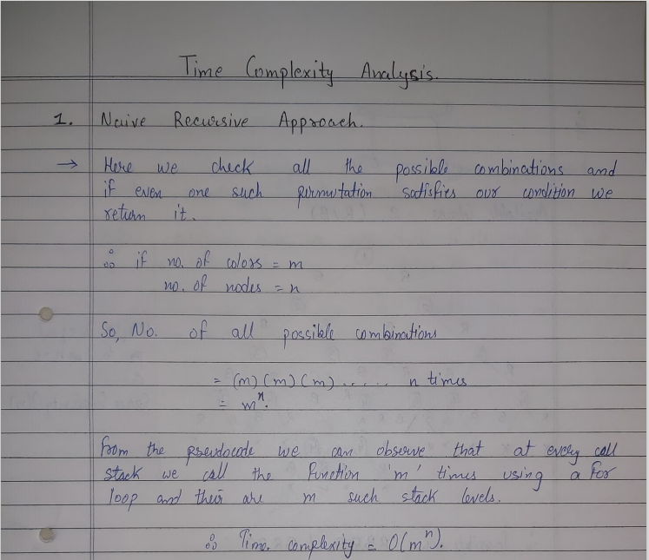

Slide 35
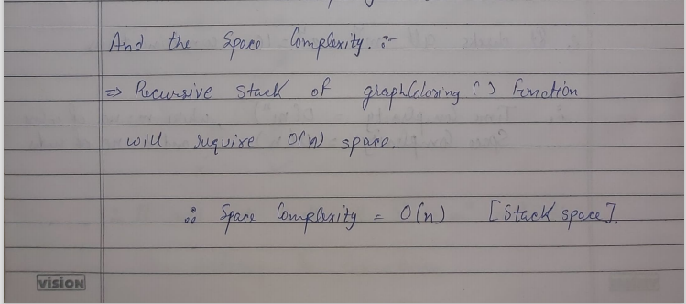

Slide 36
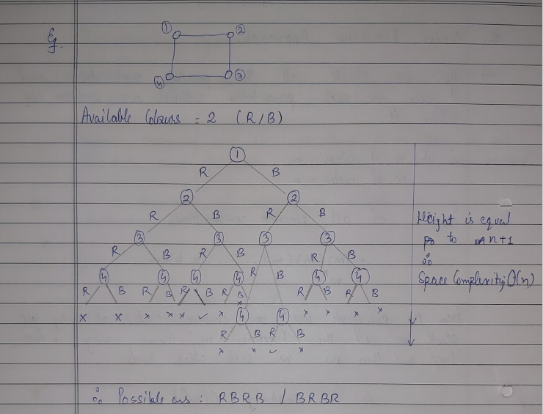

Slide 37
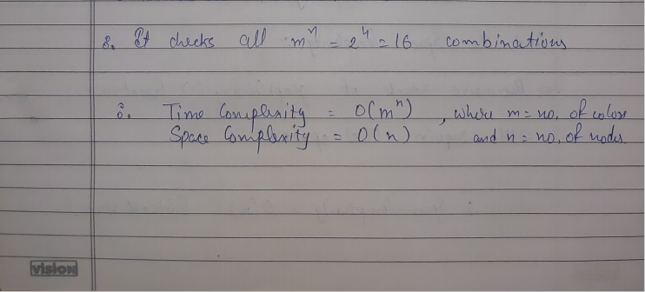

Slide 38
Approach 2 : Backtracking
Assumptions :
Here , only 3 colours since M = 3 .
White colour as colourless / un-coloured = 0
Red colour = 1
Blue colour = 2
Orange colour = 3
= temporary coloured (checking if colouring is possible or not)
A colour Array with nos. of elements = nos. of vertices = N (here = 10)
Say C[10] , and Initializing all elements with 0 ( i.e colourless )
C = { 0 , 0 , 0 , 0 , 0 , 0 , 0 , 0 , 0 , 0 };
Graph[n][n] is a binary matrix , in which if Graph[i][j] = 1 it denotes edge between
I and J and 0 means no edge .

Slide 39
Pseudocode
We have an adjacency matrix named “graph” of size n x n.
We also have an array named “color” of size n initialized to 0.
We have a function printSolution to print the array “color”

Slide 40
Pseudocode
colorGraphRecursive(int graph[V][V], int m, int i, int color[V] )
if i = V then
return true
for c = 1 to m
if isSafe(graph, color, i, c)
color[i] = c
if colorGraphRecursive (graph, m, i + 1, color) = true
return true
color[i] = 0
return false

Slide 41
Pseudocode
isSafe(int graph[V][V], int color[],int v, int c)
for i = 0 to V-1
if graph[v][i] = true and c = color[i]
return false
return true
Driver Function
1. if colorGraphRecursive (graph, m, 0, color) = false
print(“Solution does not exist”)
2. else
call printSolution(color)

Slide 42
Algorithm :
We will iterate (i) from vertex 1 to N ( i.e. 10)
And Colour Each vertex but before colouring We will check whether the vertex V will be
Coloured is safe or not .
( i.e if adjacent vertices doesn’t have
Same colour as vertex V. )
If it is different then we will
colour it and move onto next
vertex or else we will check again with different colour and repeat this process
until we get The desired result / graph.
Same Input taken as it was in Algo-1 (Naive)
1
= 1
= 2
= 3
2
4
5
3
6
7
8
9
10

Slide 43
Depth of recursion
C = { 0 , 0 , 0 , 0 , 0 , 0 , 0 , 0 , 0 , 0 }
1
= 1
i = 0
= 2
We will try to colour Vertex 1 with 1 (red) , and check whether it is possible .
= 3
2
4
5
3
6
7
8
9
10

Slide 44
Depth of recursion
C = { 1 , 0 , 0 , 0 , 0 , 0 , 0 , 0 , 0 , 0 }
1
= 1
i = 0
= 2
We will colour vertex 1 as red since Coloring is possible ,
Since all adjacent vertices are of different colour (here colourless)
= 3
2
4
5
3
6
7
8
9
10

Slide 45
Depth of recursion
C = { 1 , 0 , 0 , 0 , 0 , 0 , 0 , 0 , 0 , 0 }
1
= 1
i = 1
= 2
We will try to colour Vertex 2 with 1 (red) , and check whether it is possible .
i = 0
= 3
2
4
5
3
6
7
8
9
10

Slide 46
Depth of recursion
C = { 1 , 0 , 0 , 0 , 0 , 0 , 0 , 0 , 0 , 0 }
1
= 1
i = 1
= 2
Since Edge 1 - 2
Share same colour , therefore it is not valid , and hence we will try some other colour for vertex 2
i = 0
= 3
2
4
5
3
6
7
8
9
10

Slide 47
Depth of recursion
C = { 1 , 0 , 0 , 0 , 0 , 0 , 0 , 0 , 0 , 0 }
1
= 1
i = 1
= 2
Since Red was invalid now we will check with blue colour (next colour )
i = 0
= 3
2
4
5
3
6
7
8
9
10

Slide 48
Depth of recursion
C = { 1 , 2 , 0 , 0 , 0 , 0 , 0 , 0 , 0 , 0 }
1
= 1
i = 1
= 2
Since Blue is Valid We will colour Vertex 2 with Blue
i = 0
= 3
2
4
5
3
6
7
8
9
10

Slide 49
Depth of recursion
C = { 1 , 2 , 0 , 0 , 0 , 0 , 0 , 0 , 0 , 0 }
1
= 1
i = 2
= 2
Again , We will repeat same process for vertex 3.
We will try to colour it with red
i = 1
= 3
i = 0
2
4
5
3
6
7
8
9
10

Slide 50
Depth of recursion
C = { 1 , 2 , 0 , 0 , 0 , 0 , 0 , 0 , 0 , 0 }
1
= 1
i = 2
= 2
Since Edge 1 – 3 ,
We will try next colour blue
And check whether it is safe or not .
i = 1
= 3
i = 0
2
4
5
3
6
7
8
9
10

Slide 51
Depth of recursion
C = { 1 , 2 , 2 , 0 , 0 , 0 , 0 , 0 , 0 , 0 }
1
= 1
i = 2
= 2
Blue colour for vertex 3 is safe so we will colour it .
And move onto next vertex .
i = 1
= 3
i = 0
2
4
5
3
6
7
8
9
10

Slide 52
Depth of recursion
C = { 1 , 2 , 2 , 0 , 0 , 0 , 0 , 0 , 0 , 0 }
1
= 1
i = 3
= 2
Again same process for vertex 4 ,
Checking it with red colour .
i = 2
= 3
i = 1
2
i = 0
4
5
3
6
7
8
9
10

Slide 53
Depth of recursion
C = { 1 , 2 , 2 , 1 , 0 , 0 , 0 , 0 , 0 , 0 }
1
= 1
i = 3
= 2
Since Vertex 4 with red is safe we will colour it with red
i = 2
= 3
i = 1
2
i = 0
4
5
3
6
7
8
9
10

Slide 54
Depth of recursion
C = { 1 , 2 , 2 , 1 , 0 , 0 , 0 , 0 , 0 , 0 }
1
= 1
i = 4
= 2
Again same process
with Vertex 5 :
Here it is not safe since
4-5 edge share same colour
i = 3
= 3
i = 2
2
i = 1
i = 0
4
5
3
6
7
8
9
10

Slide 55
Depth of recursion
C = { 1 , 2 , 2 , 1 , 0 , 0 , 0 , 0 , 0 , 0 }
1
= 1
i = 4
= 2
Hence we will try next colour
i.e blue (2)
i = 3
= 3
i = 2
2
i = 1
i = 0
4
5
3
6
7
8
9
10

Slide 56
Depth of recursion
C = { 1 , 2 , 2 , 1 , 2 , 0 , 0 , 0 , 0 , 0 }
1
= 1
i = 4
= 2
Since , Vertex 5 with blue
Colour is safe , we will colour it .
And move onto next vertex .
i = 3
= 3
i = 2
2
i = 1
i = 0
4
5
3
6
7
8
9
10

Slide 57
Depth of recursion
C = { 1 , 2 , 2 , 1 , 2 , 0 , 0 , 0 , 0 , 0 }
1
= 1
i = 5
= 2
Again same with vertex 6
Checking with red colour
Here it is unsafe since 1 – 6 edge
Vertices share same colour .
i = 4
= 3
i = 3
2
i = 2
i = 1
4
5
i = 0
6
3
7
8
9
10

Slide 58
Depth of recursion
C = { 1 , 2 , 2 , 1 , 2 , 0 , 0 , 0 , 0 , 0 }
1
= 1
i = 5
= 2
Trying next colour i.e blue
Again it is NOT SAFE since
5 – 6 edge vertices share same colour .
i = 4
= 3
i = 3
2
i = 2
i = 1
4
5
i = 0
6
3
7
8
9
10

Slide 59
Depth of recursion
C = { 1 , 2 , 2 , 1 , 2 , 0 , 0 , 0 , 0 , 0 }
1
= 1
i = 5
= 2
Trying Next Colour i.e Orange .
i = 4
= 3
i = 3
2
i = 2
i = 1
4
5
i = 0
6
3
7
8
9
10

Slide 60
Depth of recursion
C = { 1 , 2 , 2 , 1 , 2 , 3 , 0 , 0 , 0 , 0 }
1
= 1
i = 5
= 2
Since vertex 6 is safe with orange , we will colour it .
And move onto next vertex .
i = 4
= 3
i = 3
2
i = 2
i = 1
4
5
i = 0
6
3
7
8
9
10

Slide 61
Depth of recursion
C = { 1 , 2 , 2 , 1 , 2 , 3 , 0 , 0 , 0 , 0 }
1
= 1
i = 6
= 2
Again same with Vertex 7 ,
Checking with red colour ,
Here it is SAFE .
i = 5
= 3
i = 4
2
i = 3
i = 2
4
5
i = 1
3
6
i = 0
7
8
9
10

Slide 62
Depth of recursion
C = { 1 , 2 , 2 , 1 , 2 , 3 , 1 , 0 , 0 , 0 }
1
= 1
i = 6
= 2
Since it is SAFE , we will colour
Vertex 7 with red . And move onto next vertex .
i = 5
= 3
i = 4
2
i = 3
i = 2
4
5
i = 1
3
6
i = 0
7
8
9
10

Slide 63
Depth of recursion
C = { 1 , 2 , 2 , 1 , 2 , 3 , 1 , 0 , 0 , 0 }
1
= 1
i = 7
= 2
Again same with Vertex 8 ,
Checking with red colour ,
Here it is NOT SAFE
Since Edge 4 – 8 share same colour .
i = 6
= 3
i = 5
2
i = 4
i = 3
4
5
i = 2
6
3
i = 1
i = 0
7
8
9
10

Slide 64
Depth of recursion
C = { 1 , 2 , 2 , 1 , 2 , 3 , 1 , 0 , 0 , 0 }
1
= 1
i = 7
= 2
Checking with next colour i.e blue colour ,
Here , it is NOT SAFE
Since , edge 8 – 2 share same colour .
i = 6
= 3
i = 5
2
i = 4
i = 3
4
5
i = 2
6
3
i = 1
i = 0
7
8
9
10

Slide 65
Depth of recursion
C = { 1 , 2 , 2 , 1 , 2 , 3 , 1 , 0 , 0 , 0 }
1
= 1
i = 7
= 2
Checking with next colour i.e orange colour ,
Here , it is SAFE
i = 6
= 3
i = 5
2
i = 4
i = 3
4
5
i = 2
6
3
i = 1
i = 0
7
8
9
10

Slide 66
Depth of recursion
C = { 1 , 2 , 2 , 1 , 2 , 3 , 1 , 3 , 0 , 0 }
1
= 1
i = 7
= 2
Since it is SAFE we will colour vertex 8 with orange and move onto next vertex .
i = 6
= 3
i = 5
2
i = 4
i = 3
4
5
i = 2
6
3
i = 1
i = 0
7
8
9
10

Slide 67
Depth of recursion
C = { 1 , 2 , 2 , 1 , 2 , 3 , 1 , 3 , 0 , 0 }
1
= 1
i = 8
= 2
Similarly on Vertex 9 ,
Red / blue colour doesnot work
Since edge 9 – 7 and 9 – 3 resp.
i = 7
= 3
i = 6
2
i = 5
i = 4
4
5
i = 3
3
6
i = 2
i = 1
7
8
i = 0
9
10

Slide 68
Depth of recursion
C = { 1 , 2 , 2 , 1 , 2 , 3 , 1 , 3 , 0 , 0 }
1
= 1
i = 8
= 2
Similarly on Vertex 9 ,
Red / blue colour doesnot work
Since edge 9 – 7 and 9 – 3 resp.
i = 7
= 3
i = 6
2
i = 5
i = 4
4
5
i = 3
3
6
i = 2
i = 1
7
8
i = 0
9
10

Slide 69
Depth of recursion
C = { 1 , 2 , 2 , 1 , 2 , 3 , 1 , 3 , 0 , 0 }
1
= 1
i = 8
= 2
Therefore with orange colour it is SAFE
i = 7
= 3
i = 6
2
i = 5
i = 4
4
5
i = 3
3
6
i = 2
i = 1
7
8
i = 0
9
10

Slide 70
Depth of recursion
C = { 1 , 2 , 2 , 1 , 2 , 3 , 1 , 3 , 3 , 0 }
1
= 1
i = 8
= 2
Colouring vertex 9 with Orange i.e 3
i = 7
= 3
i = 6
2
i = 5
i = 4
4
5
i = 3
3
6
i = 2
i = 1
7
8
i = 0
9
10

Slide 71
Depth of recursion
C = { 1 , 2 , 2 , 1 , 2 , 3 , 1 , 3 , 3 , 0 }
1
= 1
i = 9
= 2
Again same with Vertex 10
Checking with red colour ,
Here it is SAFE .
i = 8
= 3
i = 7
2
i = 6
i = 5
4
5
i = 4
3
6
i = 3
i = 2
7
8
i = 1
i = 0
9
10

Slide 72
Depth of recursion
C = { 1 , 2 , 2 , 1 , 2 , 3 , 1 , 3 , 3 , 1 }
1
= 1
i = 9
= 2
Since SAFE , we will colour vertex 10 with red ,
And move forward in recursion
i = 8
= 3
i = 7
2
i = 6
i = 5
4
5
i = 4
3
6
i = 3
i = 2
7
8
i = 1
i = 0
9
10

Slide 73
Depth of recursion
C = { 1 , 2 , 2 , 1 , 2 , 3 , 1 , 3 , 3 , 1 }
1
= 1
i = 10
= 2
SINCE I = V
We will exit all recurions since the graph we obtained is correct /
One of the possible colouring pattern .
i = 9
= 3
i = 8
2
i = 7
i = 6
4
5
i = 5
3
6
i = 4
i = 3
7
8
i = 2
i = 1
i = 0
9
10

Slide 74
Depth of recursion
C = { 1 , 2 , 2 , 1 , 2 , 3 , 1 , 3 , 3 , 1 }
1
= 1
Return true;
Return true;
Return true;
Return true;
Return true;
Return true;
Return true;
Return true;
Return true;
Return true;
Return true;
i = 10
How the algorithm exit all recurisons
(all will return true and print final answer)
= 2
i = 9
= 3
i = 8
2
i = 7
i = 6
4
5
i = 5
3
6
i = 4
i = 3
7
8
i = 2
i = 1
i = 0
And then it will
print final Colour Array
9
10

Slide 75
Here , since the initial pattern worked .
We didn’t had to go back in recursion to re-colour previous vertex in order to try some new colour combination .
Otherwise We backtrack the colour combinations and try efficiently new colour .
Only difference of Algo – 2 (Backtracking) and Algo -1 (Naive) is that we check whether each vertex is safe or not , which helps to improve time complexity for average cases ,
But it’s worst case still remains same as this is still an brute force algorithm optimization .

Slide 76
Finally :
Depth of recursion = 0
1
= 1
= 2
= 3
Final Colour Order of Vertices :
C = { 1 , 2 , 2 , 1 , 2 , 3 , 1 , 3 , 3 , 1 }
In Simpler Terms , This Algorithm is Bactracking Approach which efficiently tries all possible combination which will give better results in average cases but worst time will still remains same i.e 3¹⁰
(in this case) As seen in previous slide .
And print the right / safely m – coloured graph or returns Not Possible if it isn’t
Possible
2
4
5
3
6
7
8
9
10

Slide 77
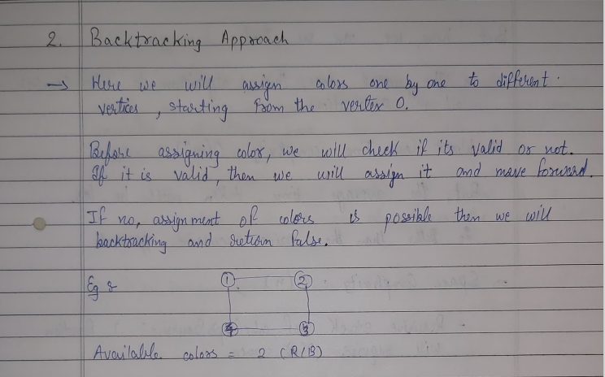

Slide 78
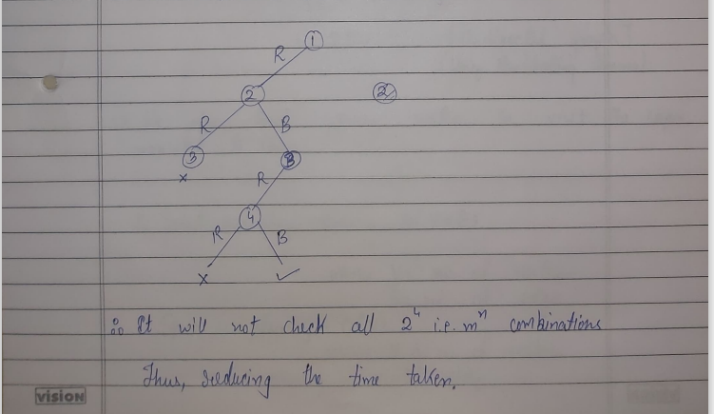

Slide 79
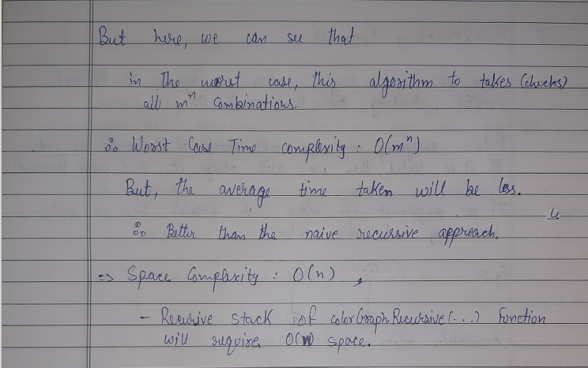

Slide 80
Approach 3 : BFS (Breadth – First – Search ) Approach
Assumptions :
Here , only 3 colours since M = 3 .
White colour as colourless / un-coloured = 0
Red colour = 1
Blue colour = 2
Orange colour = 3
We have a class named Vertex having objects "color" and a set "edges".
1. Color is initialised to 1 for every vertex.
2. Edges work as a adjacency list i.e. it stores a adjacent vertices for a particular vertex.
We have visited array of size n, initialised to 0.

Slide 81
Pseudocode
We have a class named “node” which has properties “color” which is initially equal to 1 and “edges” which is adjacency list.
We also have a vector named “visited” of size n initialized to 0.
We have a function printSolution to print the array “color”

Slide 82
graphColoring(vector<node>& nodes, int n, int m)
1. set maxColors = 1
2. for i = 1 to n
a. if visited[i] = 1
i. continue
b. visited[i] = 1
c. declare queue named “q”
d. push i in q
e. while q is not empty
i. set top = q.front()
ii. pop element from queue
iii. for e in node[top].edges
if nodes[top].color = nodes[e].color = true
nodes[e].color += 1
maxColors = max(maxColors,nodes[top].color,nodes[e].color)
if maxColors > m
return 0
if visited[e] = false
visited[e] = 1
push e in q
3. return 0

Slide 83
Adjacency List :
1 -> 2, 3, 6
2 -> 1, 7, 8
3 -> 1, 4, 9
4 -> 3, 5, 8
5 -> 4, 6, 7
6 -> 1, 5, 10
7 -> 2, 5, 9
8 -> 2, 4, 10
9 -> 3, 7, 10
10 -> 6, 8, 9
1
2
4
5
3
6
7
8
Initially , we will assign color 1 to every Vertex.
9
10
7
7
7

Slide 84
V = { 0 , 0 , 0 , 0 , 0 , 0 , 0 , 0 , 0 , 0 }
maxColors = 1
Queue : Empty
= 1
1
= 2
= 3
2
We will start iterating from node 1 to n. As, it is not visited we will then make it visited.
We will then push the vertex in our queue
4
5
3
6
7
8
9
10

Slide 85
V = { 1 , 0 , 0 , 0 , 0 , 0 , 0 , 0 , 0 , 0 }
maxColors = 1
= 1
Queue
1
= 2
= 3
1
2
1 -> 2, 3, 6
We will iterate through a set of adjacent vertices of 1 and if they are not visited we will make them visited and push it in queue. We will also Pop 1 from the Queue.
If the adjacent vertices have same color then we will increase the color number for the other vertex.
i = 1
4
5
3
6
7
8
9
10

Slide 86
V = { 1 , 1 , 0 , 0 , 0 , 0 , 0 , 0 , 0 , 0 }
maxColors = 1
= 1
Queue
1
= 2
= 3
2
2
1 -> 2, 3, 6
Here 1 and 2 have same color.
∴ Color of 2 = (1) + 1 = 2 i.e. Blue
∴ maxColors += 1
i = 1
4
5
3
6
7
8
9
10

Slide 87
V = { 1 , 1 , 1 , 0 , 0 , 0 , 0 , 0 , 0 , 0 }
maxColors = 2
= 1
Queue
1
= 2
= 3
2
3
2
1 -> 2, 3, 6
Here 1 and 3 have same color.
∴ Color of 3 = (1) + 1 = 2 i.e. Blue
maxColors remain as it is.
i = 1
4
5
3
6
7
8
9
10

Slide 88
V = { 1 , 1 , 1 , 0 , 0 , 1 , 0 , 0 , 0 , 0 }
maxColors = 2
= 1
Queue
1
= 2
2
= 3
3
6
2
1 -> 2, 3, 6
Here 1 and 6 have same color.
∴ Color of 6 = (1) + 1 = 2 i.e. Blue
maxColors remain as it is.
i = 1
4
5
3
6
8
9
10

Slide 89
V = { 1 , 1 , 1 , 0 , 0 , 1 , 0 , 0 , 0 , 0 }
maxColors = 2
= 1
Queue
1
= 2
3
= 3
6
Pop 2 from queue
2
2 -> 1, 7, 8
We will iterate through a set of adjacent vertices of 2 and if they are not visited we will make them visited and push it in queue.
If the adjacent vertices have same color then we will increase the color number for the other vertex.
i = 1
4
5
3
6
7
8
9
10

Slide 90
V = { 1 , 1 , 1 , 0 , 0 , 1 , 0 , 0 , 0 , 0 }
maxColors = 2
= 1
Queue
1
= 2
3
= 3
6
2
2 -> 1, 7, 8
As the color of 1 and 2 are different and 1 is already visited therefore we will move further.
i = 1
4
5
3
6
7
8
9
10

Slide 91
V = { 1 , 1 , 1 , 0 , 0 , 1 , 0 , 0 , 0 , 0 }
maxColors = 2
= 1
Queue
1
= 2
3
= 3
6
2
2 -> 1, 7, 8
As the color of 2 and 7 are different but 7 is not visited therefore, we will make 7 visited and push it in the queue.
i = 1
4
5
3
6
7
8
9
10

Slide 92
V = { 1 , 1 , 1 , 0 , 0 , 1 , 1 , 0 , 0 , 0 }
maxColors = 2
= 1
Queue
1
= 2
3
= 3
6
7
2
2 -> 1, 7, 8
As the color of 2 and 8 are different but 8 is not visited therefore, we will make 8 visited and push it in the queue.
i = 1
4
5
3
6
7
8
9
10

Slide 93
V = { 1 , 1 , 1 , 0 , 0 , 1 , 1 , 1 , 0 , 0 }
maxColors = 2
= 1
Queue
1
= 2
6
= 3
7
Pop 3 from the queue
8
2
3 -> 1, 4, 9
We will iterate through a set of adjacent vertices of 3 and if they are not visited we will make them visited and push it in queue.
If the adjacent vertices have same color then we will increase the color number for the other vertex.
i = 1
4
5
3
6
7
8
9
10

Slide 94
V = { 1 , 1 , 1 , 0 , 0 , 1 , 1 , 1 , 0 , 0 }
maxColors = 2
= 1
Queue
1
= 2
6
= 3
7
8
2
3 -> 1, 4, 9
As the color of 1 and 3 are different and 1 is already visited therefore we will move further.
i = 1
4
5
3
6
7
8
9
10

Slide 95
V = { 1 , 1 , 1 , 0 , 0 , 1 , 1 , 1 , 0 , 0 }
maxColors = 2
= 1
Queue
1
= 2
6
= 3
7
8
2
3 -> 1, 4, 9
As the color of 3 and 4 are different and 4 is not visited therefore we will make it visited and push it in the queue.
i = 1
4
5
3
6
7
8
9
10

Slide 96
V = { 1 , 1 , 1 , 1 , 0 , 1 , 1 , 1 , 0 , 0 }
maxColors = 2
= 1
Queue
1
= 2
6
= 3
7
8
2
4
3 -> 1, 4, 9
As the color of 3 and 9 are different and 9 is not visited therefore we will make it visited and push it in the queue.
i = 1
4
5
3
6
7
8
9
10

Slide 97
V = { 1 , 1 , 1 , 1 , 0 , 1 , 1 , 1 , 1 , 0 }
maxColors = 2
= 1
Queue
1
= 2
7
= 3
8
4
Pop 6 from the queue
2
9
6 -> 1, 5, 10
We will iterate through a set of adjacent vertices of 6 and if they are not visited we will make them visited and push it in queue.
If the adjacent vertices have same color then we will increase the color number for the other vertex.
i = 1
4
5
3
6
7
8
9
10

Slide 98
V = { 1 , 1 , 1 , 1 , 0 , 1 , 1 , 1 , 1 , 0 }
maxColors = 2
= 1
Queue
1
= 2
7
= 3
8
4
2
9
6 -> 1, 5, 10
As the color of 1 and 6 are different and 1 is already visited therefore we will move further.
i = 1
4
5
3
6
7
8
9
10

Slide 99
V = { 1 , 1 , 1 , 1 , 0 , 1 , 1 , 1 , 1 , 0 }
maxColors = 2
= 1
Queue
1
= 2
7
= 3
8
4
2
9
6 -> 1, 5, 10
As the color of 5 and 6 are different and 5 is not visited therefore we will make it visited and push it in queue.
i = 1
4
5
3
6
7
8
9
10

Slide 100
V = { 1 , 1 , 1 , 1 , 1 , 1 , 1 , 1 , 1 , 0 }
maxColors = 2
= 1
Queue
1
= 2
7
= 3
8
4
9
2
5
i = 1
6 -> 1, 5, 10
As the color of 10 and 6 are different and 10 is not visited therefore we will make it visited and push it in queue.
4
5
3
6
7
8
9
10

Slide 101
V = { 1 , 1 , 1 , 1 , 1 , 1 , 1 , 1 , 1 , 1 }
maxColors = 2
= 1
Queue
1
= 2
8
= 3
4
9
Pop 7 from the queue
5
2
10
i = 1
7-> 2, 5, 9
We will iterate through a set of adjacent vertices of 7 and if they are not visited we will make them visited and push it in queue.
If the adjacent vertices have same color then we will increase the color number for the other vertex.
4
5
3
6
7
8
9
10

Slide 102
V = { 1 , 1 , 1 , 1 , 1 , 1 , 1 , 1 , 1 , 1 }
maxColors = 2
= 1
Queue
1
= 2
8
= 3
4
9
5
2
10
i = 1
7-> 2, 5, 9
As the color of 2 and 7 are different and 2 is already visited therefore we move further.
4
5
3
6
7
8
9
10

Slide 103
V = { 1 , 1 , 1 , 1 , 1 , 1 , 1 , 1 , 1 , 1 }
maxColors = 2
= 1
Queue
1
= 2
8
= 3
4
9
5
2
10
i = 1
7-> 2, 5, 9
As the color of 7 and 5 are same .
Therefore, we will increase color of 5
Color of 5 = 1 + 1 = 2 i.e. Blue
As 5 is already visited , therefore we will not push it in queue.
4
5
3
6
7
8
9
10

Slide 104
V = { 1 , 1 , 1 , 1 , 1 , 1 , 1 , 1 , 1 , 1 }
maxColors = 2
= 1
Queue
1
= 2
8
= 3
4
9
5
2
10
i = 1
7-> 2, 5, 9
As the color of 7 and 9 are same .
Therefore, we will increase color of 9
Color of 9 = 1 + 1 = 2 i.e. Blue
As 9 is already visited , therefore we will not push it in queue.
4
5
3
6
7
8
9
10

Slide 105
V = { 1 , 1 , 1 , 1 , 1 , 1 , 1 , 1 , 1 , 1 }
maxColors = 2
= 1
Queue
1
= 2
4
= 3
9
5
Pop 8 from the queue
10
2
i = 1
8 -> 2, 4, 10
We will iterate through a set of adjacent
vertices of 8 and if they are not visited we will make them visited and push it in queue.
If the adjacent vertices have same color then we will increase the color number for the other vertex.
4
5
3
6
7
8
9
10

Slide 106
V = { 1 , 1 , 1 , 1 , 1 , 1 , 1 , 1 , 1 , 1 }
maxColors = 2
= 1
Queue
1
= 2
4
= 3
9
5
10
2
i = 1
8 -> 2, 4, 10
As the color of 2 and 8 are different and 2 is already visited therefore we move further.
4
5
3
6
7
8
9
10

Slide 107
V = { 1 , 1 , 1 , 1 , 1 , 1 , 1 , 1 , 1 , 1 }
maxColors = 2
= 1
Queue
1
= 2
4
= 3
9
5
10
2
i = 1
8 -> 2, 4, 10
As the color of 4 and 8 are same .
Therefore, we will increase color of 4
Color of 4 = 1 + 1 = 2 i.e. Blue
As 4 is already visited , therefore we will not push it in queue.
4
5
3
6
7
8
9
10

Slide 108
V = { 1 , 1 , 1 , 1 , 1 , 1 , 1 , 1 , 1 , 1 }
maxColors = 2
= 1
Queue
1
= 2
4
= 3
9
5
10
2
i = 1
8 -> 2, 4, 10
As the color of 10 and 8 are same .
Therefore, we will increase color of 10
Color of 10 = 1 + 1 = 2 i.e. Blue
As 10 is already visited , therefore we will not push it in queue.
4
5
3
6
7
8
9
10

Slide 109
V = { 1 , 1 , 1 , 1 , 1 , 1 , 1 , 1 , 1 , 1 }
maxColors = 2
= 1
Queue
1
= 2
9
= 3
5
10
Pop 4 from the queue
2
i = 1
4 -> 3, 5, 8
We will iterate through a set of adjacent vertices of 4 and if they are not visited we will make them visited and push it in queue.
If the adjacent vertices have same color then we will increase the color number for the other vertex.
4
5
3
6
7
8
9
10

Slide 110
V = { 1 , 1 , 1 , 1 , 1 , 1 , 1 , 1 , 1 , 1 }
maxColors = 2
= 1
Queue
1
= 2
9
= 3
5
10
2
i = 1
4 -> 3, 5, 8
As the color of 3 and 4 are same .
Therefore, we will increase color of 3
Color of 3 = 2 + 1 = 3 i.e. Orange
maxColors = 3
As 3 is already visited , therefore we will not push it in queue.
4
5
3
6
7
8
9
10

Slide 111
V = { 1 , 1 , 1 , 1 , 1 , 1 , 1 , 1 , 1 , 1 }
maxColors = 3
= 1
Queue
1
= 2
9
= 3
5
10
2
i = 1
4 -> 3, 5, 8
As the color of 5 and 4 are same .
Therefore, we will increase color of 5
Color of 5 = 2 + 1 = 3 i.e. Orange
As 5 is already visited , therefore we will not push it in queue.
4
5
3
6
7
8
9
10

Slide 112
V = { 1 , 1 , 1 , 1 , 1 , 1 , 1 , 1 , 1 , 1 }
maxColors = 3
= 1
Queue
1
= 2
9
= 3
5
10
2
i = 1
4 -> 3, 5, 8
As the color of 4 and 8 are different and 8 is already visited therefore, we move further.
4
5
3
6
7
8
9
10

Slide 113
V = { 1 , 1 , 1 , 1 , 1 , 1 , 1 , 1 , 1 , 1 }
maxColors = 3
= 1
Queue
1
= 2
5
= 3
10
Pop 9 from the queue
2
i = 1
9 -> 3, 7, 10
We will iterate through a set of adjacent
vertices of 4 and if they are not visited we
will make them visited and push it in queue.
If the adjacent vertices have same color then we will increase the color number for the
other vertex
4
5
3
6
7
8
9
10

Slide 114
V = { 1 , 1 , 1 , 1 , 1 , 1 , 1 , 1 , 1 , 1 }
maxColors = 3
= 1
Queue
1
= 2
5
= 3
10
2
i = 1
9 -> 3, 7, 10
As the color of 3 and 9 are different and 3 is already visited therefore, we move further.
4
5
3
6
7
8
9
10

Slide 115
V = { 1 , 1 , 1 , 1 , 1 , 1 , 1 , 1 , 1 , 1 }
maxColors = 3
= 1
Queue
1
= 2
5
= 3
10
2
i = 1
9 -> 3, 7, 10
As the color of 7 and 9 are different and 7 is already visited therefore, we move further.
4
5
3
6
7
8
9
10

Slide 116
V = { 1 , 1 , 1 , 1 , 1 , 1 , 1 , 1 , 1 , 1 }
maxColors = 3
= 1
Queue
1
= 2
5
= 3
10
2
i = 1
9 -> 3, 7, 10
As the color of 10 and 9 are same .
Therefore, we will increase color of 10
Color of 10 = 2 + 1 = 3 i.e. Orange
As 10 is already visited , therefore we will not push it in queue
4
5
3
6
7
8
9
10

Slide 117
V = { 1 , 1 , 1 , 1 , 1 , 1 , 1 , 1 , 1 , 1 }
maxColors = 3
= 1
Queue
1
= 2
10
= 3
Pop 5 from the queue
2
i = 1
5 -> 4, 6, 7
We will iterate through a set of adjacent
vertices of 5 and if they are not visited we
will make them visited and push it in queue.
If the adjacent vertices have same color then we will increase the color number for the
other vertex
4
5
3
6
7
8
9
10

Slide 118
V = { 1 , 1 , 1 , 1 , 1 , 1 , 1 , 1 , 1 , 1 }
maxColors = 3
= 1
Queue
1
= 2
10
= 3
2
i = 1
5 -> 4, 6, 7
As the color of 5 and 4 are different and 4 is already visited therefore, we move further.
4
5
3
6
7
8
9
10

Slide 119
V = { 1 , 1 , 1 , 1 , 1 , 1 , 1 , 1 , 1 , 1 }
maxColors = 3
= 1
Queue
1
= 2
10
= 3
2
i = 1
5 -> 4, 6, 7
As the color of 5 and 6 are different and 6 is already visited therefore, we move further.
4
5
3
6
7
8
9
10

Slide 120
V = { 1 , 1 , 1 , 1 , 1 , 1 , 1 , 1 , 1 , 1 }
maxColors = 3
= 1
Queue
1
= 2
10
= 3
2
i = 1
5 -> 4, 6, 7
As the color of 5 and 7 are different and 7 is already visited therefore, we move further.
4
5
3
6
7
8
9
10

Slide 121
V = { 1 , 1 , 1 , 1 , 1 , 1 , 1 , 1 , 1 , 1 }
maxColors = 3
= 1
Queue
1
= 2
= 3
Pop 10 from the queue
2
i = 1
10 -> 6, 8, 9
We will iterate through a set of adjacent
vertices of 10 and if they are not visited we
will make them visited and push it in queue.
If the adjacent vertices have same color then we will increase the color number for the
other vertex.
4
5
3
6
7
8
9
10

Slide 122
V = { 1 , 1 , 1 , 1 , 1 , 1 , 1 , 1 , 1 , 1 }
maxColors = 3
= 1
Queue
1
= 2
= 3
2
i = 1
10 -> 6, 8, 9
As the color of 10 and 6 are different and 6 is already visited therefore, we move further.
4
5
3
6
7
8
9
10

Slide 123
V = { 1 , 1 , 1 , 1 , 1 , 1 , 1 , 1 , 1 , 1 }
maxColors = 3
= 1
Queue
1
= 2
= 3
2
i = 1
10 -> 6, 8, 9
As the color of 10 and 8 are different and 8 is already visited therefore, we move further.
4
5
3
6
7
8
9
10

Slide 124
V = { 1 , 1 , 1 , 1 , 1 , 1 , 1 , 1 , 1 , 1 }
maxColors = 3
= 1
Queue
1
= 2
= 3
2
i = 1
10 -> 6, 8, 9
As the color of 10 and 9 are different and 9 is already visited therefore, we move further.
4
5
3
6
7
8
9
10

Slide 125
V = { 1 , 1 , 1 , 1 , 1 , 1 , 1 , 1 , 1 , 1 }
maxColors = 3
= 1
Queue
1
= 2
= 3
2
Since the queue is empty now , we will move
To next i.e. i = 2 , but when we will check the
visited condition it will satisfy it.
Therefore, we will not revisit it.
This will happen for all such remaining i’s which
are i = 2 to 10 as our graph was connected.
At the end our program terminates.
4
5
3
6
7
8
9
10

Slide 126
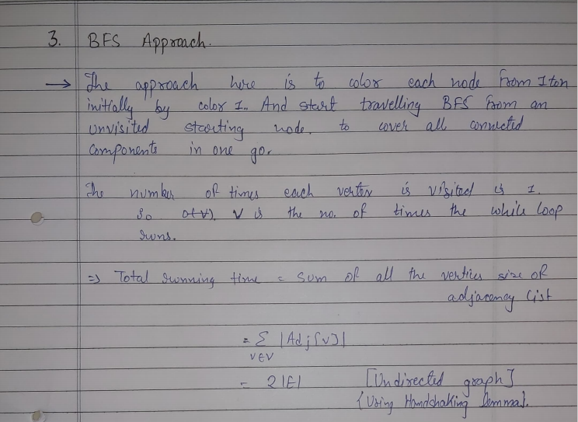

Slide 127
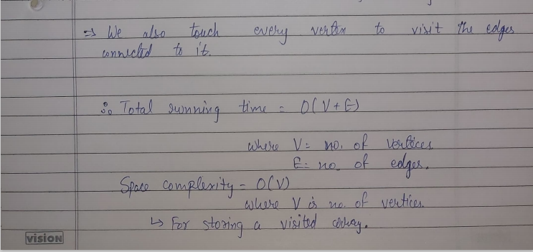

Slide 128
Algorithm | Time Complexity | Space Complexity
Naïve Recursive | O(m^{n}) | O(n) : Stack Calls/Space
Backtracking | O(m^{n}) | O(n) : Stack Calls/Space
BFS | O(V+E) | O(V) : For Storing Visited Array
Note : Backtracking performs much better than naïve recursive approach in almost all case i.e. Average Cases.

Slide 129
Application of M – Colouring Problem
Map Colouring
We are supposed to colour the states / union territories of a country,
India such that the states / Uts sharing the borders do not have same
colour.
India comprises of 28 states and 9 union territories.
We need to colour all 37 entities according to the condition specified above.
The maximum colours we can use are 4.
We will use BFS method to colour the map.

Slide 130
State code (GST) | Name of the state/Uts | Neighbouring States/Uts
1 | Jammu and Kashmir | 2,3,37
2 | Himachal Pradesh | 1,3,5,6,9,37
3 | Punjab | 1,2,4,6,8
4 | Chandigarh | 3,6
5 | Uttarakhand | 2,6,9
6 | Haryana | 2,3,4,5,7,8,9
7 | Delhi | 6,9
8 | Rajasthan | 3,6,9,23,24
9 | Uttar Pradesh | 2,5,6,7,8,10,20,22,23
10 | Bihar | 9,19,20
11 | Sikkim | 19
12 | Arunachal Pradesh | 13,18
13 | Nagaland | 12,14,18
14 | Manipur | 13,15,18
15 | Mizoram | 14,16,18
16 | Tripura | 15,18
17 | Meghalaya | 18
18 | Assam | 12,13,14,15,16,17,19
19 | West Bengal | 10,11,18,20,21
20 | Jharkhand | 9,10,19,21,22,23

Slide 131
21 | Odisha | 19,20,22,28
22 | Chattisgarh | 9,20,21,23,27,28,36
23 | Madhya Pradesh | 8,9,22,24,27
24 | Gujarat | 8,23,25,26,27
25 | Daman and Diu | 24
26 | Dadra and Nagar Haveli | 24,27
27 | Maharashtra | 22,23,24,26,29,30,36
28 | Andhra Pradesh | 21,22,29,33,34,36
29 | Karnataka | 27,28,30,32,33,36
30 | Goa | 27,29
31 | Lakshadweep Islands
32 | Kerala | 29,33,34
33 | Tamil Nadu | 28,29,32,34
34 | Pondicherry | 28,32,33
35 | Andaman and Nicobar Islands
36 | Telangana | 22,27,28,29
37 | Ladakh | 1,2

Slide 132
We will start iterating through all the nodes i.e. from i = 1 to n
If it is not visited then we will make it visited and push it in queue.
Then we will iterate till queue is not empty :
We will pop the element from the queue.
Then iterate through the adjacency list of that element.
If the vertex is not visited then, we will add them in the queue .
and check if their colour are same then we will increase the colour of latter vertex.
When the queue becomes empty we will move to next node.
We will initialize all entities to colour 1.

Slide 133
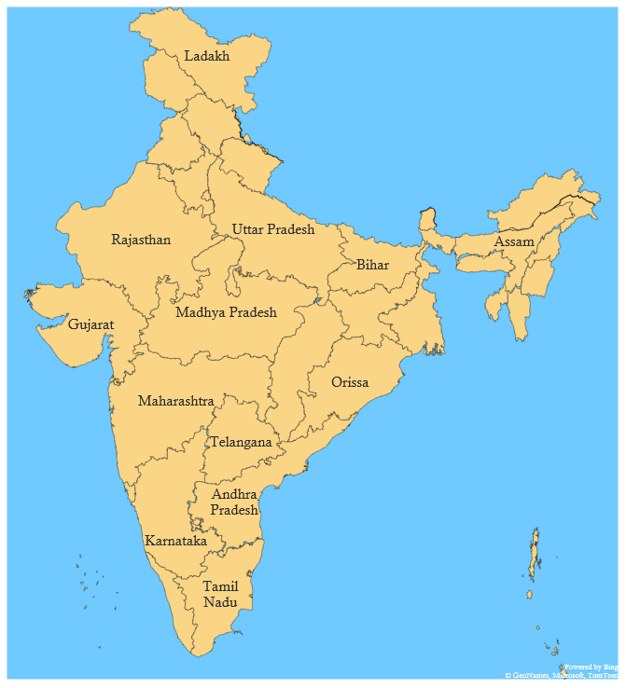
Visited : [0,0,0,0,0,0,0,0,0,0,0,0,0,0,0,0,0,0,0,0,0,0,0,0,0,0,0,
0,0,0,0,0,0,0,0,0,0]
Queue : [Empty]
i = 1
1
37
2
3
5
6
11
12
8
9
18
13
10
17
1 : Jammu and Kashmir
-> 2, 3, 37
Since, 1 is not visited
Therefore we will push 1 in queue.
And make it visited.
14
24
20
16
15
19
23
22
21
27
36
30
29
28
34
35
31
32
33
1
2
3
4

Slide 134
Visited : [1,0,0,0,0,0,0,0,0,0,0,0,0,0,0,0,0,0,0,0,0,0,0,0,0,0,0,
0,0,0,0,0,0,0,0,0,0]
Queue : [1]
i = 1
1
37
2
3
5
6
11
12
8
9
18
13
10
17
1 : Jammu and Kashmir
-> 2, 3, 37
Pop 1 from queue.
We will check each adjacent states and if they are not
Visited then make them visited and push it in queue.
14
24
20
16
15
19
23
22
21
27
36
30
29
28
34
35
31
32
33
1
2
3
4

Slide 135
Visited : [1,0,0,0,0,0,0,0,0,0,0,0,0,0,0,0,0,0,0,0,0,0,0,0,0,0,0,
0,0,0,0,0,0,0,0,0,0]
Queue : [Empty]
i = 1
1
37
2
3
5
6
11
12
8
9
18
13
10
17
1 : Jammu and Kashmir
-> 2, 3, 37
Since, Color of 1 and 2 are same .
Therefore color of 2 is increased by 1.
And also it is not visited, therefore we will push it in
queue
14
24
20
16
15
19
23
22
21
27
36
30
29
28
34
35
31
32
33
1
2
3
4

Slide 136
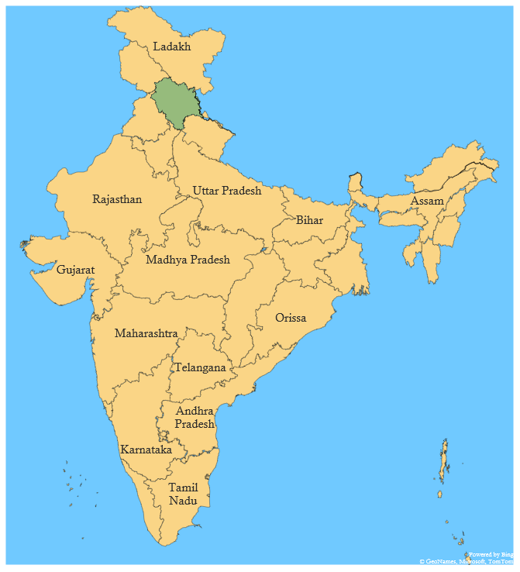
Visited : [1,1,0,0,0,0,0,0,0,0,0,0,0,0,0,0,0,0,0,0,0,0,0,0,0,0,0,
0,0,0,0,0,0,0,0,0,0]
Queue : [2,]
i = 1
1
37
2
3
5
6
11
12
8
9
18
13
10
17
1 : Jammu and Kashmir
-> 2, 3, 37
Since, Color of 1 and 3 are same .
Therefore color of 3 is increased by 1.
And also it is not visited, therefore we will push it in
queue
14
24
20
16
15
19
23
22
21
27
36
30
29
28
34
35
31
32
33
1
2
3
4

Slide 137
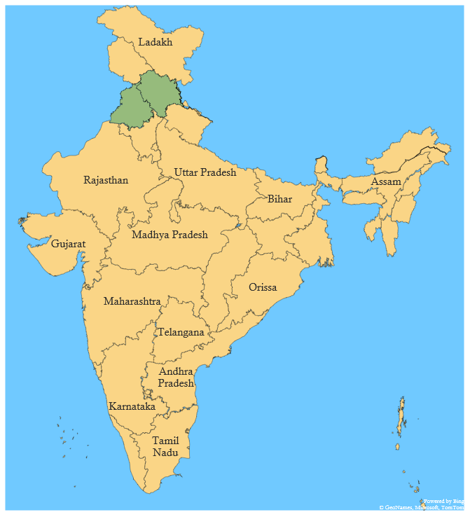
Visited : [1,1,1,0,0,0,0,0,0,0,0,0,0,0,0,0,0,0,0,0,0,0,0,0,0,0,
0,0,0,0,0,0,0,0,0,0]
Queue : [2,3]
i = 1
1
37
2
3
5
6
11
12
8
9
18
13
10
17
1 : Jammu and Kashmir
-> 2, 3, 37
Since, Color of 1 and 37 are same .
Therefore color of 37 is increased by 1.
And also it is not visited, therefore we will push it in
queue
14
24
20
16
15
19
23
22
21
27
36
30
29
28
34
35
31
32
33
1
2
3
4

Slide 138
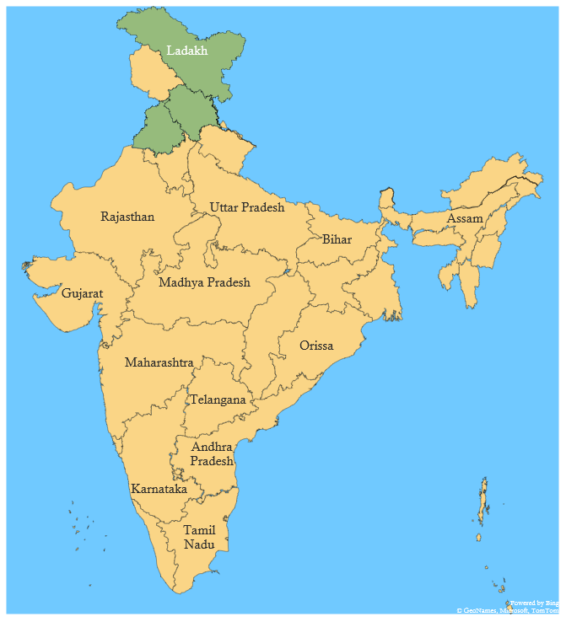
Visited : [1,1,1,0,0,0,0,0,0,0,0,0,0,0,0,0,0,0,0,0,0,0,0,0,0,0,
0,0,0,0,0,0,0,0,0,1]
Queue : [2,3,37]
i = 1
1
37
2
3
5
6
11
12
8
9
18
13
10
17
2 : Himachal Pradesh
2 -> 1, 3,5,6,37
Pop 2 from queue.
We will check each adjacent states and if they are not
Visited then make them visited and push it in queue.
14
24
20
16
15
19
23
22
21
27
36
30
29
28
34
35
31
32
33
1
2
3
4

Slide 139
Visited : [1,1,1,0,0,0,0,0,1,0,0,0,0,0,0,0,0,0,0,0,0,0,0,0,0,0,
0,0,0,0,0,0,0,0,0,1]
Queue : [3,37]
i = 1
1
37
2
3
5
6
11
12
8
9
18
13
10
17
2 : Himachal Pradesh
2 -> 1, 3,5,6,9,37
Since, Color of 1 and 2 are different and 1 is already
visited.
Therefore we will move further.
14
24
20
16
15
19
23
22
21
27
36
30
29
28
34
35
31
32
33
1
2
3
4

Slide 140
Visited : [1,1,1,0,0,0,0,0,0,0,0,0,0,0,0,0,0,0,0,0,0,0,0,0,0,0,
0,0,0,0,0,0,0,0,0,1]
Queue : [3,37]
i = 1
1
37
2
3
5
6
11
12
8
9
18
13
10
17
2 : Himachal Pradesh
-> 1, 3,5,6,9,37
Since, Color of 2 and 3 are same .
Therefore color of 3 is increased by 1.
And it is visited, therefore we will not push it in
Queue.
14
24
20
16
15
19
23
22
21
27
36
30
29
28
34
35
31
32
33
1
2
3
4

Slide 141
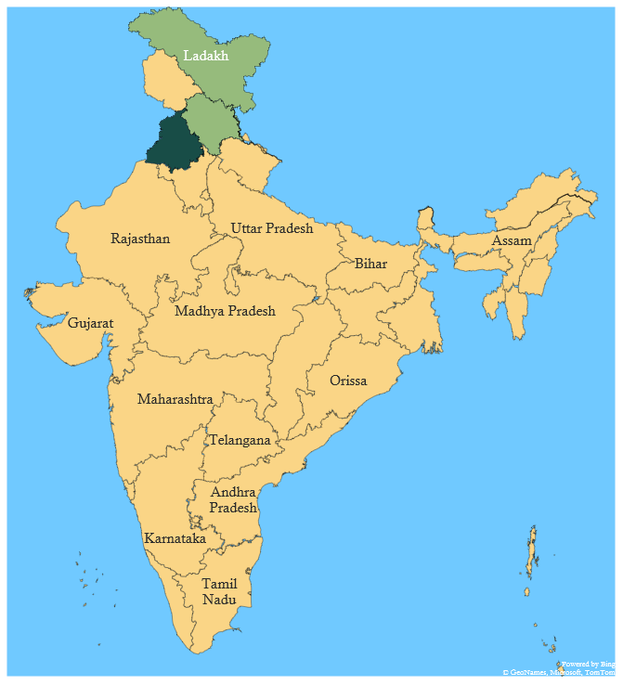
Visited : [1,1,1,0,0,0,0,0,0,0,0,0,0,0,0,0,0,0,0,0,0,0,0,0,0,0,
0,0,0,0,0,0,0,0,0,1]
Queue : [3,37]
i = 1
1
37
2
3
5
6
11
12
8
9
18
13
10
17
2 : Himachal Pradesh
-> 1, 3,5,6,9,37
Since, Color of 2 and 5 are different and 5 is not
Visited, therefore we will make it visited and push it in
Queue.
14
24
20
16
15
19
23
22
21
27
36
30
29
28
34
35
31
32
33
1
2
3
4

Slide 142
Visited : [1,1,1,0,1,0,0,0,0,0,0,0,0,0,0,0,0,0,0,0,0,0,0,0,0,0,
0,0,0,0,0,0,0,0,0,1]
Queue : [3,37,5]
i = 1
1
37
2
3
5
6
11
12
8
9
18
13
10
17
2 : Himachal Pradesh
-> 1, 3,5,6,9,37
Since, Color of 2 and 6 are different and 6 is not
Visited, therefore we will make it visited and push it in
Queue.
14
24
20
16
15
19
23
22
21
27
36
30
29
28
34
35
31
32
33
1
2
3
4

Slide 143
Visited : [1,1,1,0,1,0,0,0,1,0,0,0,0,0,0,0,0,0,0,0,0,0,0,0,0,0,
0,0,0,0,0,0,0,0,0,1]
Queue : [3,37,5,6]
i = 1
1
37
2
3
5
6
11
12
8
9
18
13
10
17
2 : Himachal Pradesh
-> 1, 3,5,6,9,37
Since, Color of 2 and 9 are different and 9 is not
Visited, therefore we will make it visited and push it in
Queue.
14
24
20
16
15
19
23
22
21
27
36
30
29
28
34
35
31
32
33
1
2
3
4

Slide 144
Visited : [1,1,1,0,1,1,0,0,1,0,0,0,0,0,0,0,0,0,0,0,0,0,0,0,0,0,
0,0,0,0,0,0,0,0,0,1]
Queue : [3,37,5,6,9]
i = 1
1
37
2
3
5
6
11
12
8
9
18
13
10
17
2 : Himachal Pradesh
-> 1, 3,5,6,9,37
Since, Color of 2 and 37 are same.
Therefore color of 37 is increased by 1.
And it is visited, therefore we will not push it in
Queue.
14
24
20
16
15
19
23
22
21
27
36
30
29
28
34
35
31
32
33
1
2
3
4

Slide 145
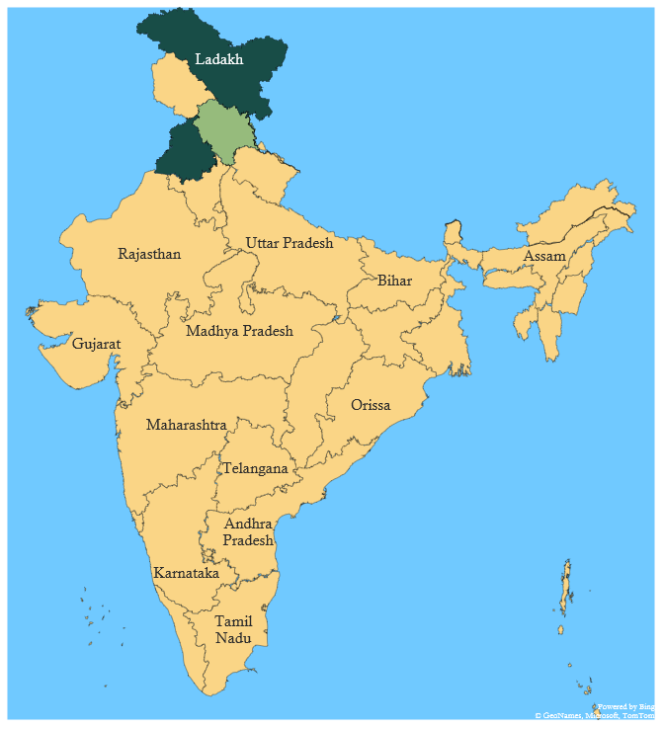
Visited : [1,1,1,0,1,1,0,0,1,0,0,0,0,0,0,0,0,0,0,0,0,0,0,0,0,0,
0,0,0,0,0,0,0,0,0,1]
Queue : [3,37,5,6,9]
i = 1
1
37
2
3
5
6
11
12
8
9
18
13
10
17
3 : Punjab
3 -> 1, 2,4,6,8
Pop 2 from queue.
We will check each adjacent states and if they are not
Visited then make them visited and push it in queue.
14
24
20
16
15
19
23
22
21
27
36
30
29
28
34
35
31
32
33
1
2
3
4

Slide 146
Visited : [1,1,1,0,1,1,0,0,1,0,0,0,0,0,0,0,0,0,0,0,0,0,0,0,0,0,
0,0,0,0,0,0,0,0,0,1]
Queue : [37,5,6,9]
i = 1
1
37
2
3
5
6
11
12
8
9
18
13
10
17
3 : Punjab
3 -> 1, 2,4,6,8
Since, Color of 1 and 3 are different and 1 is already
visited.
Therefore we will move further.
14
24
20
16
15
19
23
22
21
27
36
30
29
28
34
35
31
32
33
1
2
3
4

Slide 147
Visited : [1,1,1,0,1,1,0,0,1,0,0,0,0,0,0,0,0,0,0,0,0,0,0,0,0,0,
0,0,0,0,0,0,0,0,0,1]
Queue : [37,5,6,9]
i = 1
1
37
2
3
5
6
11
12
8
9
18
13
10
17
3 : Punjab
3 -> 1, 2,4,6,8
Since, Color of 2 and 3 are different and 2 is already
visited.
Therefore we will move further.
14
24
20
16
15
19
23
22
21
27
36
30
29
28
34
35
31
32
33
1
2
3
4

Slide 148
Visited : [1,1,1,0,1,1,0,0,1,0,0,0,0,0,0,0,0,0,0,0,0,0,0,0,0,0,
0,0,0,0,0,0,0,0,0,1]
Queue : [37,5,6,9]
i = 1
1
37
4
2
3
5
6
11
12
8
9
18
13
10
17
3 : Punjab
3 -> 1, 2,4,6,8
Since, Color of 4 and 3 are different and 4 is not visited.
Therefore we make it visited and push it in queue.
14
24
20
16
15
19
23
22
21
27
36
30
29
28
34
35
31
32
33
1
2
3
4

Slide 149
Visited : [1,1,1,1,1,1,0,0,1,0,0,0,0,0,0,0,0,0,0,0,0,0,0,0,0,0,
0,0,0,0,0,0,0,0,0,1]
Queue : [37,5,6,9,4]
i = 1
1
37
2
3
5
6
11
12
8
9
18
13
10
17
3 : Punjab
3 -> 1, 2,4,6,8
Since, Color of 6 and 3 are different and 6 is already
visited.
Therefore we will move further.
14
24
20
16
15
19
23
22
21
27
36
30
29
28
34
35
31
32
33
1
2
3
4

Slide 150
Visited : [1,1,1,1,1,1,0,0,1,0,0,0,0,0,0,0,0,0,0,0,0,0,0,0,0,0,
0,0,0,0,0,0,0,0,0,1]
Queue : [37,5,6,9,4]
i = 1
1
37
2
3
5
6
11
12
8
9
18
13
10
17
3 : Punjab
3 -> 1, 2,4,6,8
Since, Color of 8 and 3 are different and 8 is not visited.
Therefore we make it visited and push it in queue.
14
24
20
16
15
19
23
22
21
27
36
30
29
28
34
35
31
32
33
1
2
3
4

Slide 151
Visited : [1,1,1,1,1,1,0,1,1,0,0,0,0,0,0,0,0,0,0,0,0,0,0,0,0,0,
0,0,0,0,0,0,0,0,0,1]
Queue : [37,5,6,9,4,8]
i = 1
1
37
2
3
5
6
11
12
8
9
18
13
10
17
37 : Ladakh
37 -> 1, 2
We will Pop 37 from the queue.
So, we will follow the same steps as we did before.
And the Scenario after each pop would be as shown
Directly.
14
24
20
16
15
19
23
22
21
27
36
30
29
28
34
35
31
32
33
1
2
3
4

Slide 152
Visited : [1,1,1,1,1,1,0,1,1,0,0,0,0,0,0,0,0,0,0,0,0,0,0,0,0,0,
0,0,0,0,0,0,0,0,0,1]
Queue : [5,6,9,4,8]
i = 1
1
37
2
3
5
6
11
12
8
9
18
13
After Popping 37 (Ladakh) and performing all steps :
Now pop 5 from the queue.
10
17
14
24
20
16
15
19
23
22
21
27
36
30
29
28
34
35
31
32
33
1
2
3
4

Slide 153
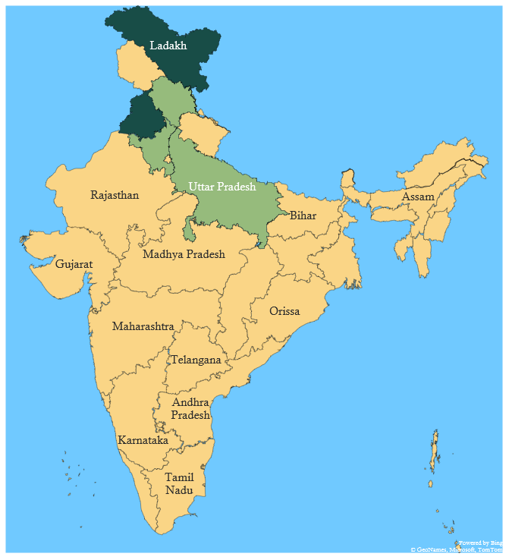
Visited : [1,1,1,1,1,1,0,1,1,0,0,0,0,0,0,0,0,0,0,0,0,0,0,0,0,0,
0,0,0,0,0,0,0,0,0,1]
Queue : [6,9,4,8]
i = 1
1
37
2
3
5
6
11
12
8
9
18
13
5 -> 2,6,9
After Popping 5 (Uttarakhand) and performing all steps :
Now pop 6 from the queue.
10
17
14
24
20
16
15
19
23
22
21
27
36
30
29
28
34
35
31
32
33
1
2
3
4

Slide 154
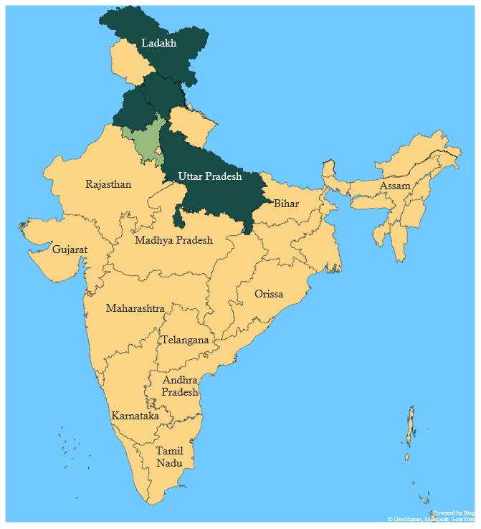
Visited : [1,1,1,1,1,1,1,1,1,0,0,0,0,0,0,0,0,0,0,0,0,0,0,0,0,0,
0,0,0,0,0,0,0,0,0,1]
Queue : [9,4,8,7]
i = 1
1
37
2
3
5
6
11
12
8
9
18
13
6 -> 2,3,4,5,7,8,9
After Popping 6 (Haryana) and performing all steps :
Now pop 9 from the queue.
10
17
14
24
20
16
15
19
23
22
21
27
36
30
29
28
34
35
31
32
33
1
2
3
4

Slide 155
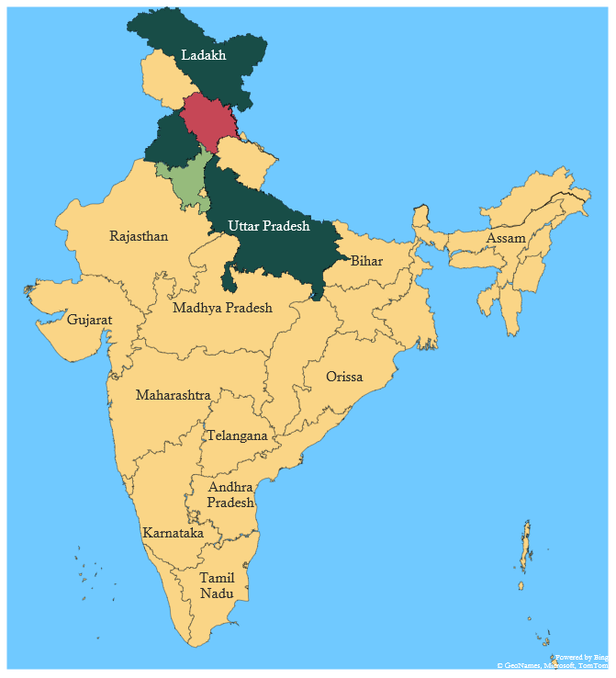
Visited : [1,1,1,1,1,1,1,1,1,1,0,0,0,0,0,0,0,0,0,1,0,1,1,0,0,0,
0,0,0,0,0,0,0,0,0,1]
Queue : [4,8,7,10,20,22,23]
i = 1
1
37
2
3
5
6
11
12
8
9
18
13
9 -> 2,5,6,7,8,10,20,22,23
After Popping 9 (UttarPradesh) and performing
all steps :
Now pop 4 from the queue.
10
17
14
24
20
16
15
19
23
22
21
27
36
30
29
28
34
35
31
32
33
1
2
3
4

Slide 156
Visited : [1,1,1,1,1,1,1,1,1,1,0,0,0,0,0,0,0,0,0,1,0,1,1,0,0,0,
0,0,0,0,0,0,0,0,0,1]
Queue : [8,7,10,20,22,23]
i = 1
1
37
2
3
5
6
11
12
8
9
18
13
4 -> 3,6
After Popping 4 (Chandigarh) and performing
all steps :
Now pop 8 from the queue.
10
17
14
24
20
16
15
19
23
22
21
27
36
30
29
28
34
35
31
32
33
1
2
3
4

Slide 157
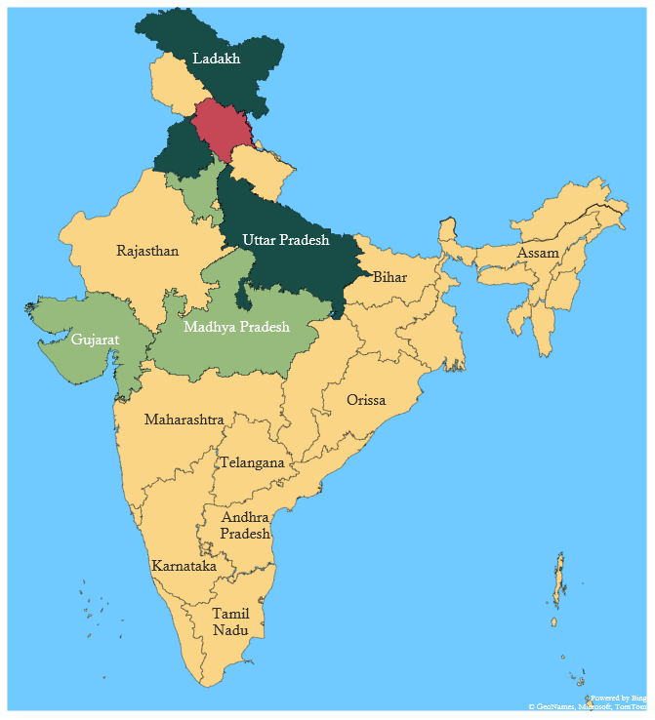
Visited : [1,1,1,1,1,1,1,1,1,1,0,0,0,0,0,0,0,0,0,1,0,1,1,1,0,0,
0,0,0,0,0,0,0,0,0,1]
Queue : [7,10,20,22,23,24]
i = 1
1
37
2
3
5
6
11
12
8
9
18
13
8 -> 3,6,9,23,24
After Popping 8 (Rajasthan) and performing
all steps :
Now pop 7 from the queue.
10
17
14
24
20
16
15
19
23
22
21
27
36
30
29
28
34
35
31
32
33
1
2
3
4

Slide 158
Visited : [1,1,1,1,1,1,1,1,1,1,0,0,0,0,0,0,0,0,0,1,0,1,1,1,0,0,
0,0,0,0,0,0,0,0,0,1]
Queue : [10,20,22,23,24]
i = 1
1
37
2
3
5
6
11
12
8
9
18
13
7 -> 6,9
After Popping 7 (Delhi) and performing
all steps :
Now pop 10 from the queue.
10
17
14
24
20
16
15
19
23
22
21
27
36
30
29
28
34
35
31
32
33
1
2
3
4

Slide 159
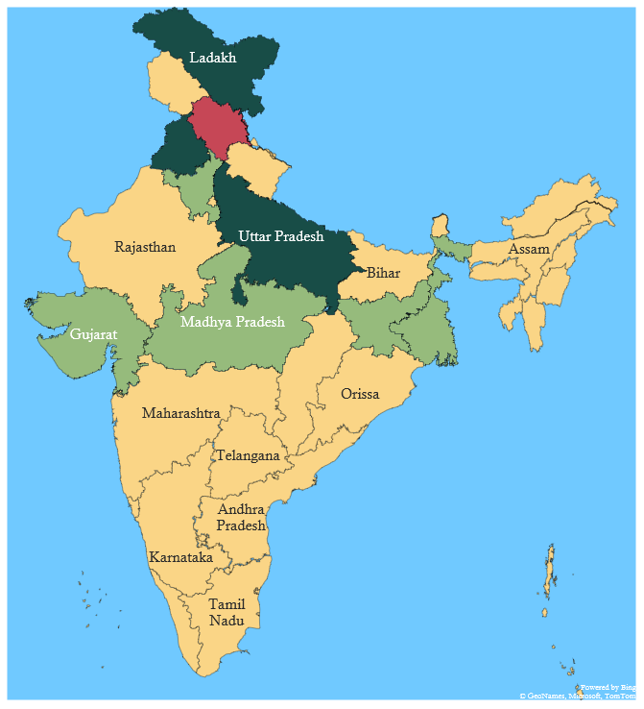
Visited : [1,1,1,1,1,1,1,1,1,1,0,0,0,0,0,0,0,0,1,1,0,1,1,1,0,0,
0,0,0,0,0,0,0,0,0,1]
Queue : [20,22,23,24,19]
i = 1
1
37
2
3
5
6
11
12
8
9
18
13
10 -> 9,19,20
After Popping 10 (Bihar) and performing
all steps :
Now pop 20 from the queue.
10
17
14
24
20
16
15
19
23
22
21
27
36
30
29
28
34
35
31
32
33
1
2
3
4

Slide 160
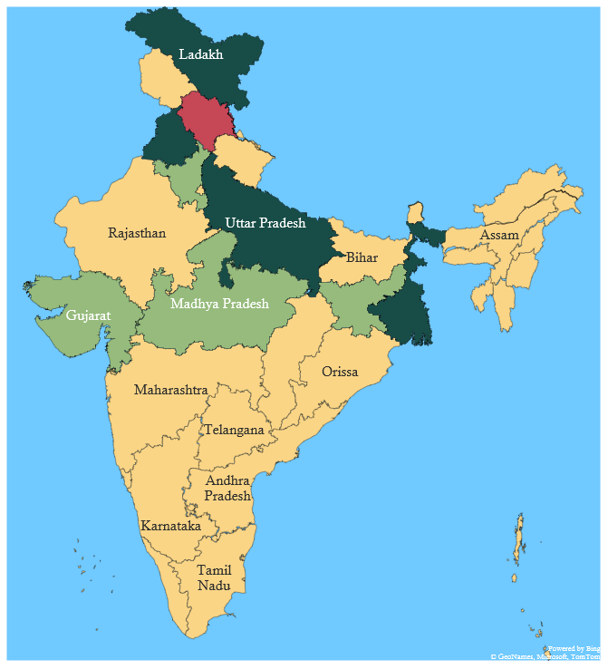
Visited : [1,1,1,1,1,1,1,1,1,1,0,0,0,0,0,0,0,0,1,1,1,1,1,1,0,0,
0,0,0,0,0,0,0,0,0,1]
Queue : [22,23,24,19,21]
i = 1
1
37
2
3
5
6
11
12
8
9
18
13
20 -> 9,10,19,21,22
After Popping 20 (Jharkhand) and performing
all steps :
Now pop 22 from the queue.
10
17
14
24
20
16
15
19
23
22
21
27
36
30
29
28
34
35
31
32
33
1
2
3
4

Slide 161
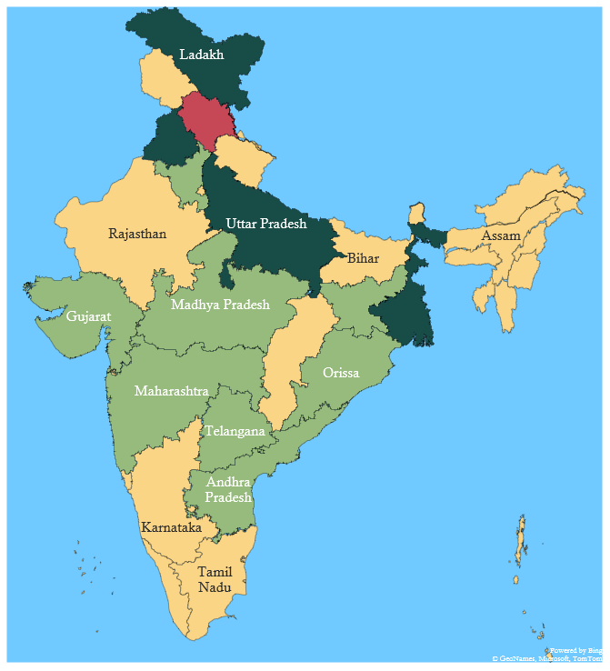
Visited : [1,1,1,1,1,1,1,1,1,1,0,0,0,0,0,0,0,0,1,1,1,1,1,1,0,0,
1,1,0,0,0,0,0,0,1,1]
Queue : [23,24,19,21,27,28,36]
i = 1
1
37
2
3
5
6
11
12
8
9
18
13
22 -> 9,20,21,23,27,28,36
After Popping 22 (Chattisgarh) and performing
all steps :
Now pop 23 from the queue.
10
17
14
24
20
16
15
19
23
22
21
27
36
30
29
28
34
35
31
32
33
1
2
3
4

Slide 162
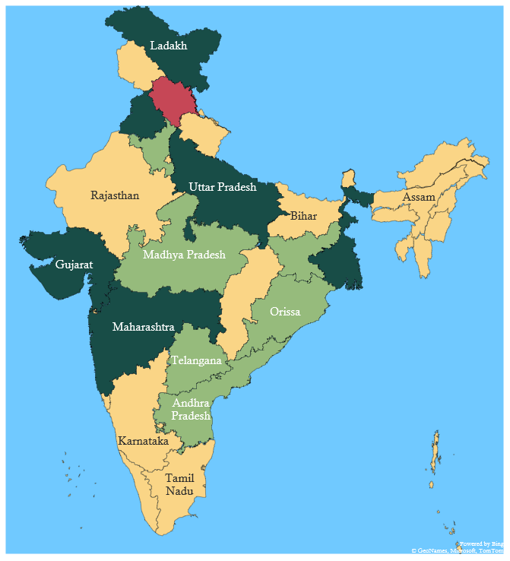
Visited : [1,1,1,1,1,1,1,1,1,1,0,0,0,0,0,0,0,0,1,1,1,1,1,1,0,0,
1,1,0,0,0,0,0,0,1,1]
Queue : [24,19,21,27,28,36]
i = 1
1
37
2
3
5
6
11
12
8
9
18
13
23 -> 8,9,22,24,27
After Popping 23 (Madhya Pradesh) and performing
all steps :
Now pop 24 from the queue.
10
17
14
24
20
16
15
19
23
22
21
27
36
30
29
28
34
35
31
32
33
1
2
3
4

Slide 163
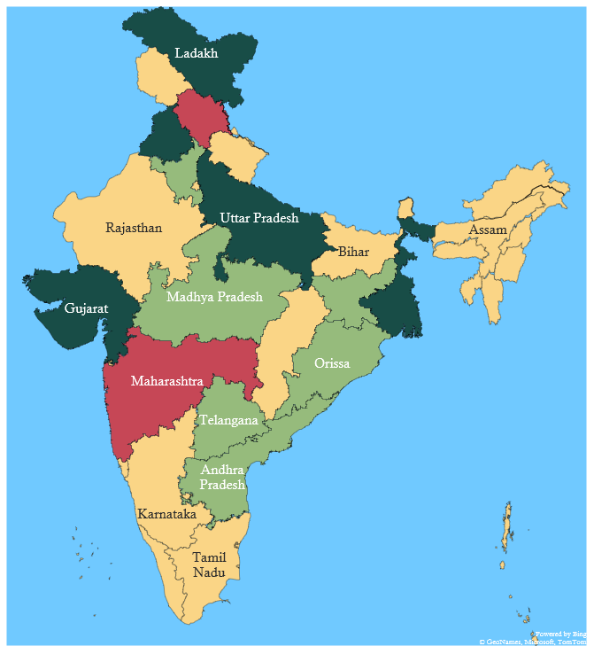
Visited : [1,1,1,1,1,1,1,1,1,1,0,0,0,0,0,0,0,0,1,1,1,1,1,1,1,1,
1,1,0,0,0,0,0,0,1,1]
Queue : [19,21,27,28,36,25,26]
i = 1
1
37
2
3
5
6
11
12
8
9
18
13
24 -> 8,23,25,26,27
After Popping 24 (Gujarat) and performing
all steps :
Now pop 19 from the queue.
10
17
14
24
20
16
15
19
23
22
21
27
36
30
29
28
34
35
31
32
33
1
2
3
4

Slide 164
Visited : [1,1,1,1,1,1,1,1,1,1,1,0,0,0,0,0,0,1,1,1,1,1,1,1,1,1,
1,1,0,0,0,0,0,0,1,1]
Queue : [21,27,28,36,25,26,11,18]
i = 1
1
37
2
3
5
6
11
12
8
9
18
13
19 -> 10,11,18,20,21
After Popping 19 (West Bengal) and performing
all steps :
10
17
14
24
20
16
15
19
23
22
21
27
36
30
29
28
34
35
31
32
33
1
2
3
4

Slide 165
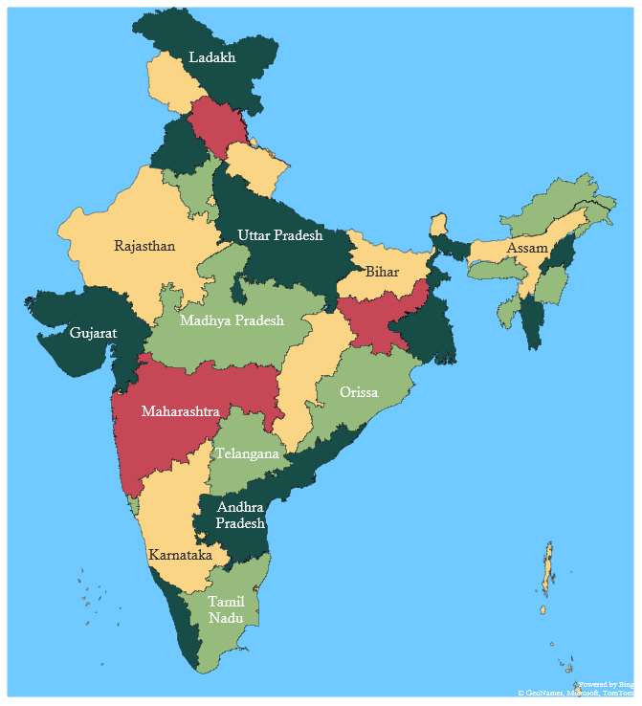
Visited : [1,1,1,1,1,1,1,1,1,1,1,1,1,1,1,1,1,1,1,1,1,1,1,1,1,1,
1,1,1,0,1,1,1,0,1,1]
Queue : [Empty]
i = 1
1
37
2
3
5
6
11
12
8
9
18
13
So, we will iterate similarly till the queue is not empty.
And the Colouring would be as :
10
17
14
24
20
16
15
19
23
22
21
27
36
30
29
28
34
35
31
32
33
1
2
3
4

Slide 166
Visited : [1,1,1,1,1,1,1,1,1,1,1,1,1,1,1,1,1,1,1,1,1,1,1,1,1,1,
1,1,1,0,1,1,1,0,1,1]
Queue : [Empty]
1
37
2
3
5
6
11
12
8
9
18
13
Now we will iterate through i = 2 to 37, but for
i = 2 to 30 , 32 to 34, 36, 37 , they are already visited
Therefore we will not perform steps for this nodes
Unlike we did for i = 1.
Since, 31 and 35 are not visited .
Therefore we will push them into queue.
10
17
14
24
20
16
15
19
23
22
21
27
36
30
29
28
34
35
31
32
33
1
2
3
4

Slide 167
Visited : [1,1,1,1,1,1,1,1,1,1,1,1,1,1,1,1,1,1,1,1,1,1,1,1,1,1,
1,1,1,1,1,1,1,0,1,1]
Queue : [31]
i = 31
1
37
2
3
5
6
11
12
8
9
18
13
-> NULL
We made 31 as visited and pushed it in queue.
Now, we will pop it in queue and iterate through all
Adjacent vertices.
But it does not have any vertices.
So, we will move further from i = 32 to 34.
Then push 35 in queue.
10
17
14
24
20
16
15
19
23
22
21
27
36
30
29
28
34
35
31
32
33
1
2
3
4

Slide 168
Visited : [1,1,1,1,1,1,1,1,1,1,1,1,1,1,1,1,1,1,1,1,1,1,1,1,1,1,
1,1,1,1,1,1,1,1,1,1]
Queue : [35]
i = 35
1
37
2
3
5
6
11
12
8
9
18
13
-> NULL
We made 35 as visited and pushed it in queue.
Now, we will pop it in queue and iterate through all
Adjacent vertices.
But it does not have any vertices.
So, we will move further from i = 36 to 37.
10
17
14
24
20
16
15
19
23
22
21
27
36
30
29
28
34
35
31
32
33

Slide 169
Maximum Colours Used : 4
1
37
2
State code (GST) | Name of the state/Uts | Colour No.
1 | Jammu and Kashmir | 1
2 | Himachal Pradesh | 4
3 | Punjab | 3
4 | Chandigarh | 1
5 | Uttarakhand | 1
6 | Haryana | 2
7 | Delhi | 1
8 | Rajasthan | 1
9 | Uttar Pradesh | 3
10 | Bihar | 1
11 | Sikkim | 1
12 | Arunachal Pradesh | 2
13 | Nagaland | 3
14 | Manipur | 2
15 | Mizoram | 3
16 | Tripura | 2
17 | Meghalaya | 2
18 | Assam | 1
19 | West Bengal | 3
20 | Jharkhand | 4
3
5
6
11
12
8
9
18
13
10
17
14
24
20
16
15
19
23
22
21
27
36
30
29
28
34
35
31
32
33
1
2
3
4

Slide 170
Maximum Colours Used : 4
1
37
2
3
5
21 | Odisha | 2
22 | Chattisgarh | 1
23 | Madhya Pradesh | 2
24 | Gujarat | 3
25 | Daman and Diu | 1
26 | Dadra and Nagar Haveli | 1
27 | Maharashtra | 4
28 | Andhra Pradesh | 3
29 | Karnataka | 1
30 | Goa | 2
31 | Lakshadweep Islands | 1
32 | Kerala | 3
33 | Tamil Nadu | 2
34 | Pondicherry | 1
35 | Andaman and Nicobar Islands | 1
36 | Telangana | 2
37 | Ladakh | 3
6
11
12
8
9
18
13
10
17
14
24
20
16
15
19
23
22
21
27
36
30
29
28
34
35
31
32
33
1
2
3
4

Slide 171
Thank You !

